Slide 1
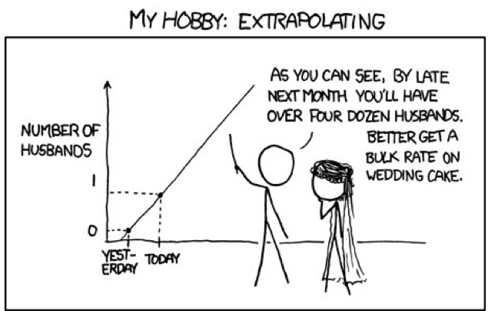
Forecasting,
Extrapolation and Uncertainty
http://xkcd.com
Notes:
Climate change, and the ecoloigcal response to it

Slide 2
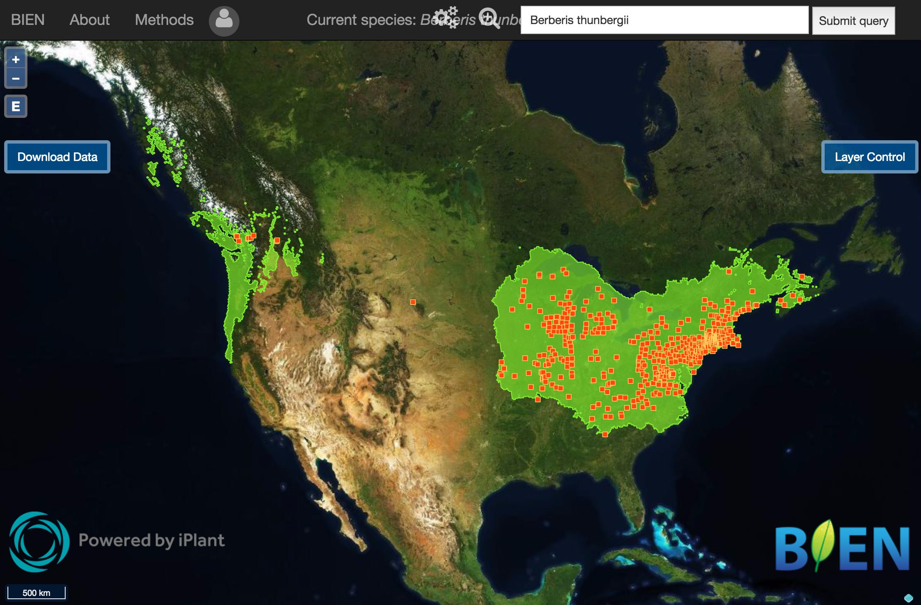
Occurrence patterns: starting point
Global Change Demography Biodiversity Communities Synthesis
Only geographic data available for most species
Facilitates studying many species and large extents
biendata.org

Slide 3

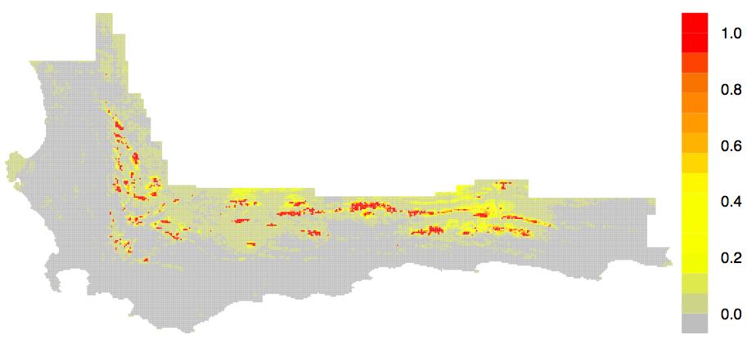
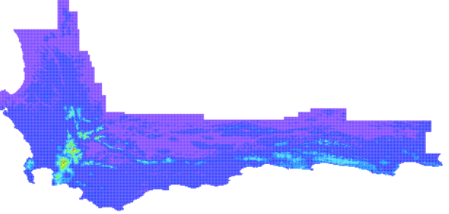
Occurrence
Global Change Demography Biodiversity Communities Synthesis
Presences
wet dry
Protea punctata
Predictions
occurrence
probability
Annual Precipitation
Maxent Guide: Merow et al., 2013, Ecography
Maxent v. Maxlike: Merow et al., 2014, MEE
Complexity: Merow et al., 2014, Ecography
Minxent: Merow et al., 2016, GEB
Expert Maps: Merow et al., 2017, GEB

Slide 4
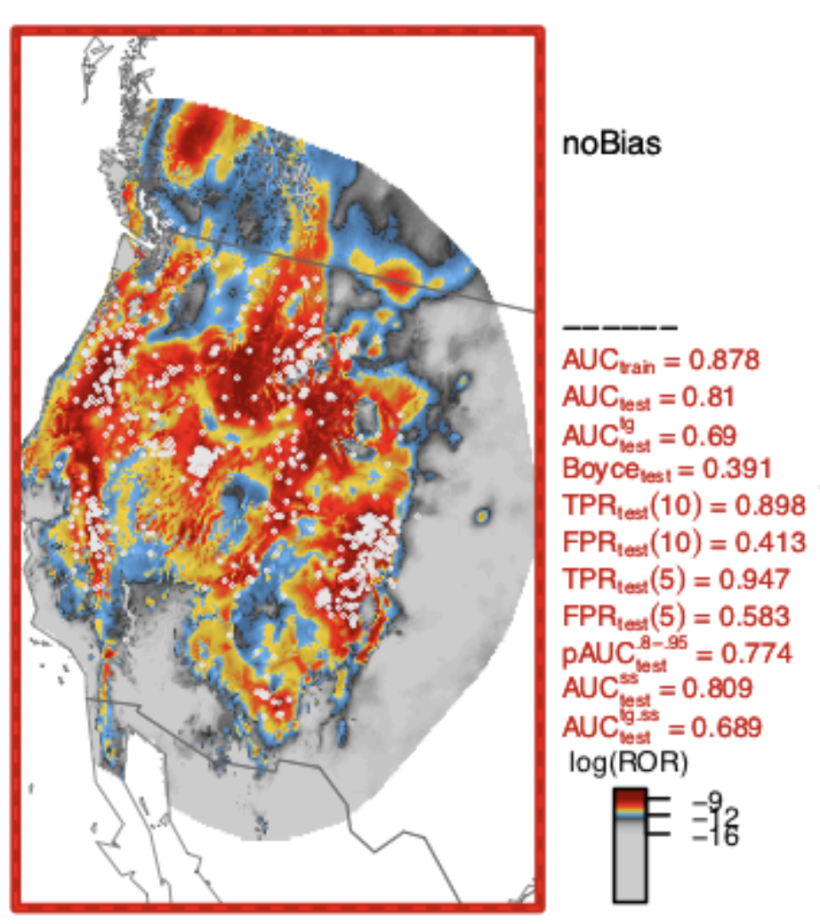
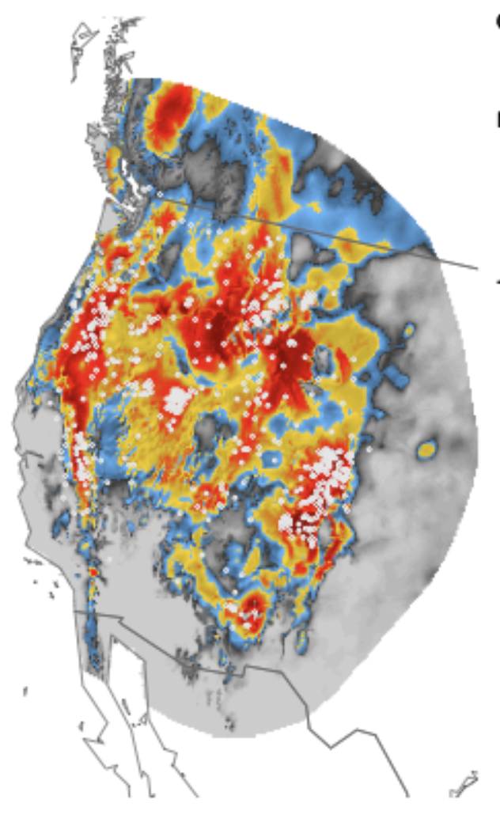
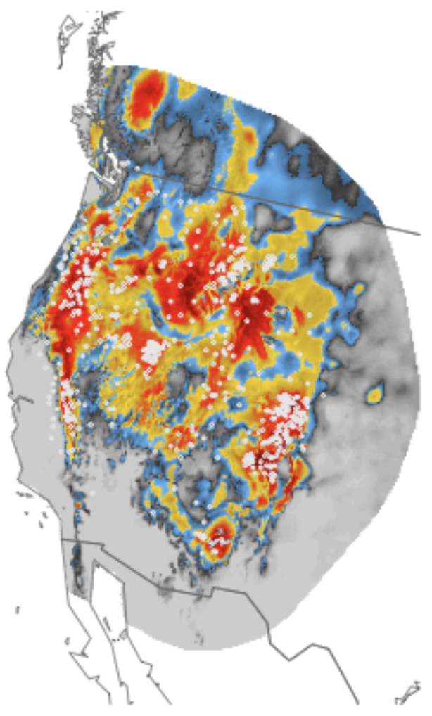
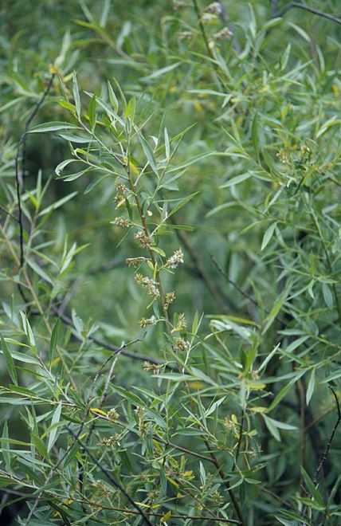
Future Forecasts
Present
2050: RCP 8.5
2070: RCP 8.5
Salix geyeriana
Notes:
New updates out this year

Slide 5
Outline
Case study
Types of extrapolation
Environment*
Space
Time
Uncertainty
Modeling decisions
Parameters
Future Scenarios
Where can
biology provide guidance?

Slide 6
Case Study

Slide 7
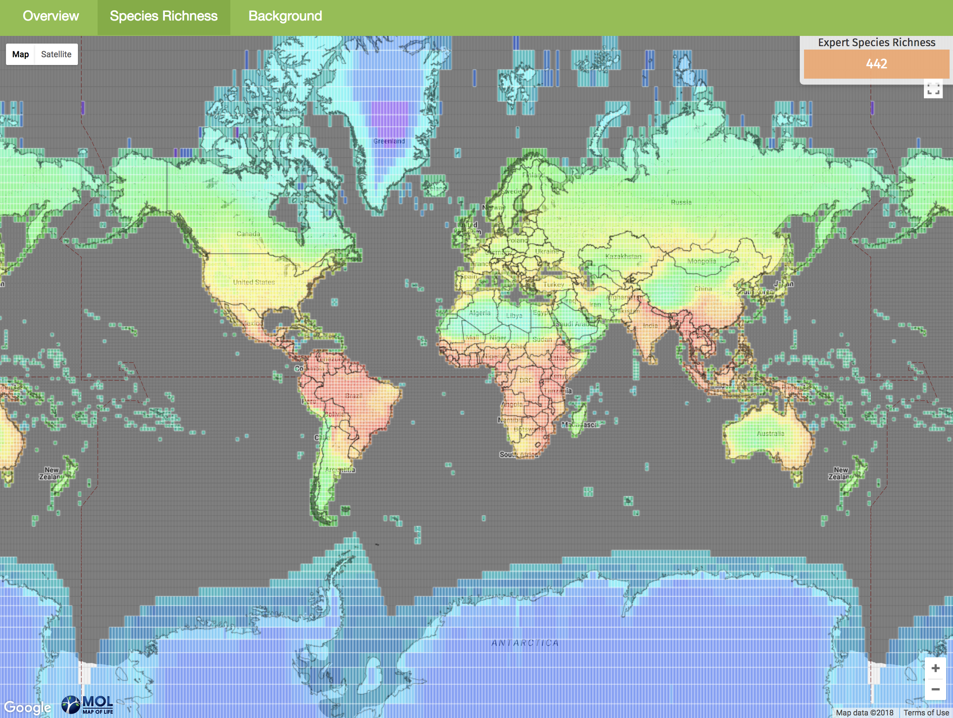
Projected regional distribution losses of terrestrial vertebrates under different climate and land-use change scenarios

Slide 8



Goals
Forecast potential range loss for ~20k
How do
land use change and climate change
contribute to
expected range loss this century?
Notes:
Land use hasn’t been considered globally and in homogenized scenarios Understanding drivers – cliamte is more global responsibility and land use is more local
You can’t build a park to protect againts climate change but you can put it in a place that’s expected to have a relatively lower impact
Not frogs, lions and eagles, but rather amphibians mammals and birds globally
Right now its only reproducibly by me, but that’s a start…

Slide 9

Informing IPBES
International Panel on Biodiversity and Ecosystem Services
‘provides policymakers with objective scientific assessments about the state of knowledge regarding the planet’s biodiversity, ecosystems and the benefits they provide to people’
Notes:
Like IPCC for biodiversity

Slide 10
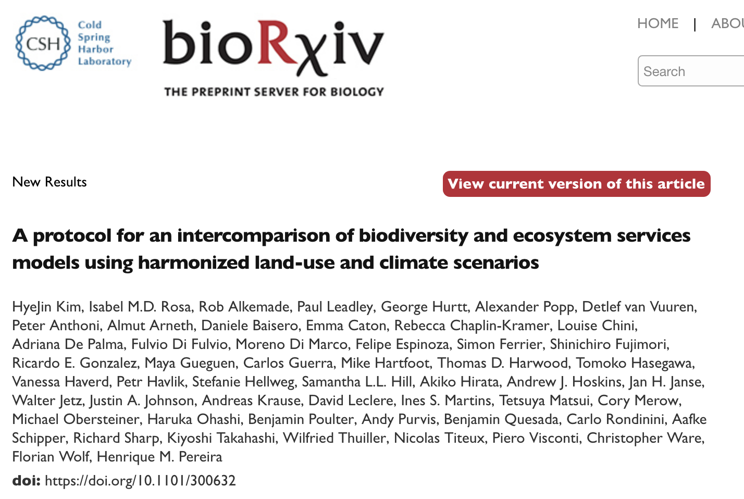
Informing IPBES
Notes:
Comparison on the way for future biodiversity change
My first adventure into biodiversity assessment, not macroecology

Slide 11
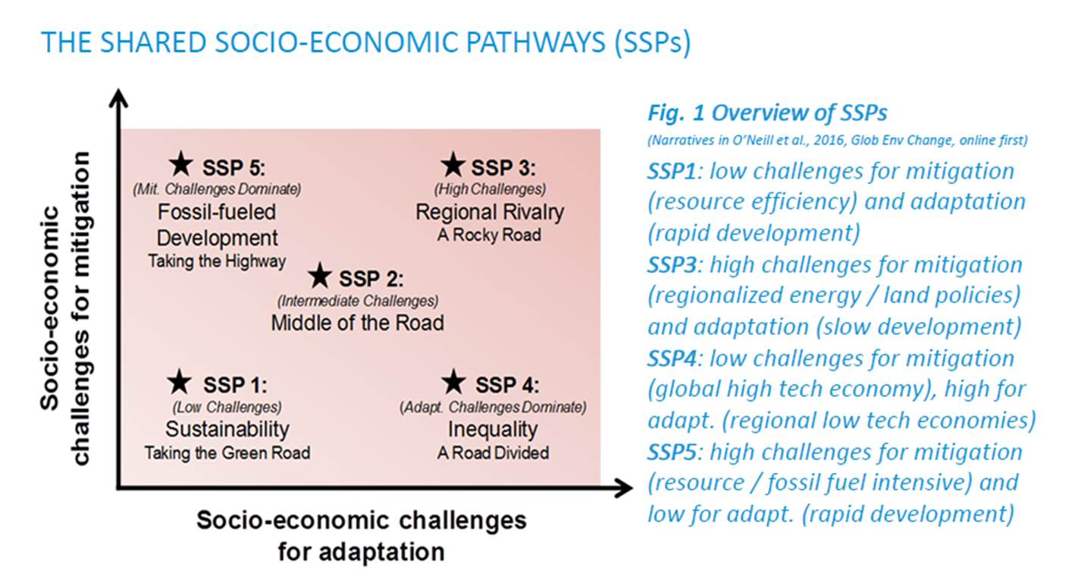
Scenarios of:
Demographics
Human development
Economy and lifestyle
Policies and institutions
Technology
Environment/natural resources
O’Neill et al. 2017 Glob. Env. Change
Land Use Harmonization 2 Project: luh.umd.edu
Notes:
… just because you may not be familiar with the SSPs
Interesting contrast in ssp5 vs ssp4
descriptions of future conditions that are relevant for both the analysis of emissions drivers and mitigation strategies

Slide 12
RCP 8.5
Scenarios of:
Demographics
Human development
Economy and lifestyle
Policies and institutions
Technology
Environment/natural resources
RCP 4.5
RCP 2.6
RCP 6.0
From O’Neill et al. 2017 Glob. Env. Change

Slide 13
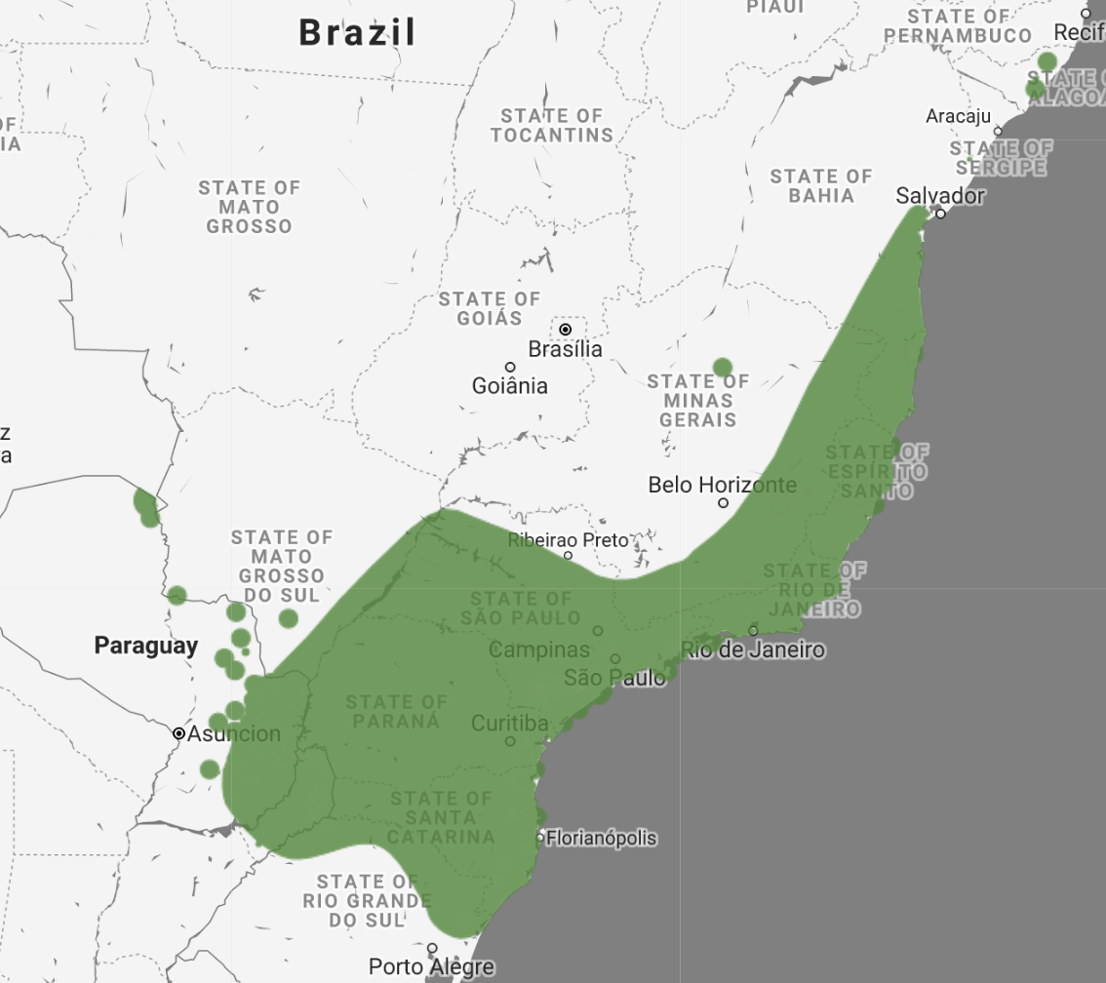


Inputs
Expert Maps
~20k amphibians, mammals and birds
Species habitat preferences
forest, agriculture, urban, etc.
Present and Future Land use maps
.25 degree
Present and Future Climate
Maxnet
Grain of predictions: .25 degree

Slide 14
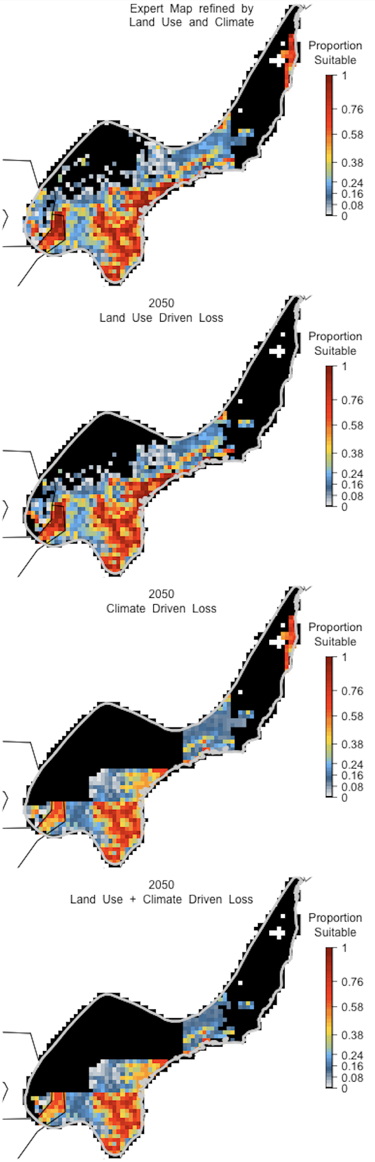
Partitioning land use and climate losses
Expert Map Refined by
Land Use and
Climate in 2015

Slide 15
Partitioning land use and climate losses
Expert Map Refined by
Land Use and
Climate in 2015
2050
Land Use Driven Loss

Slide 16
Partitioning land use and climate losses
Expert Map Refined by
Land Use and
Climate in 2015
2050
Climate Driven Loss
2050
Land Use Driven Loss
2050
Land Use +
Climate Driven Loss

Slide 17
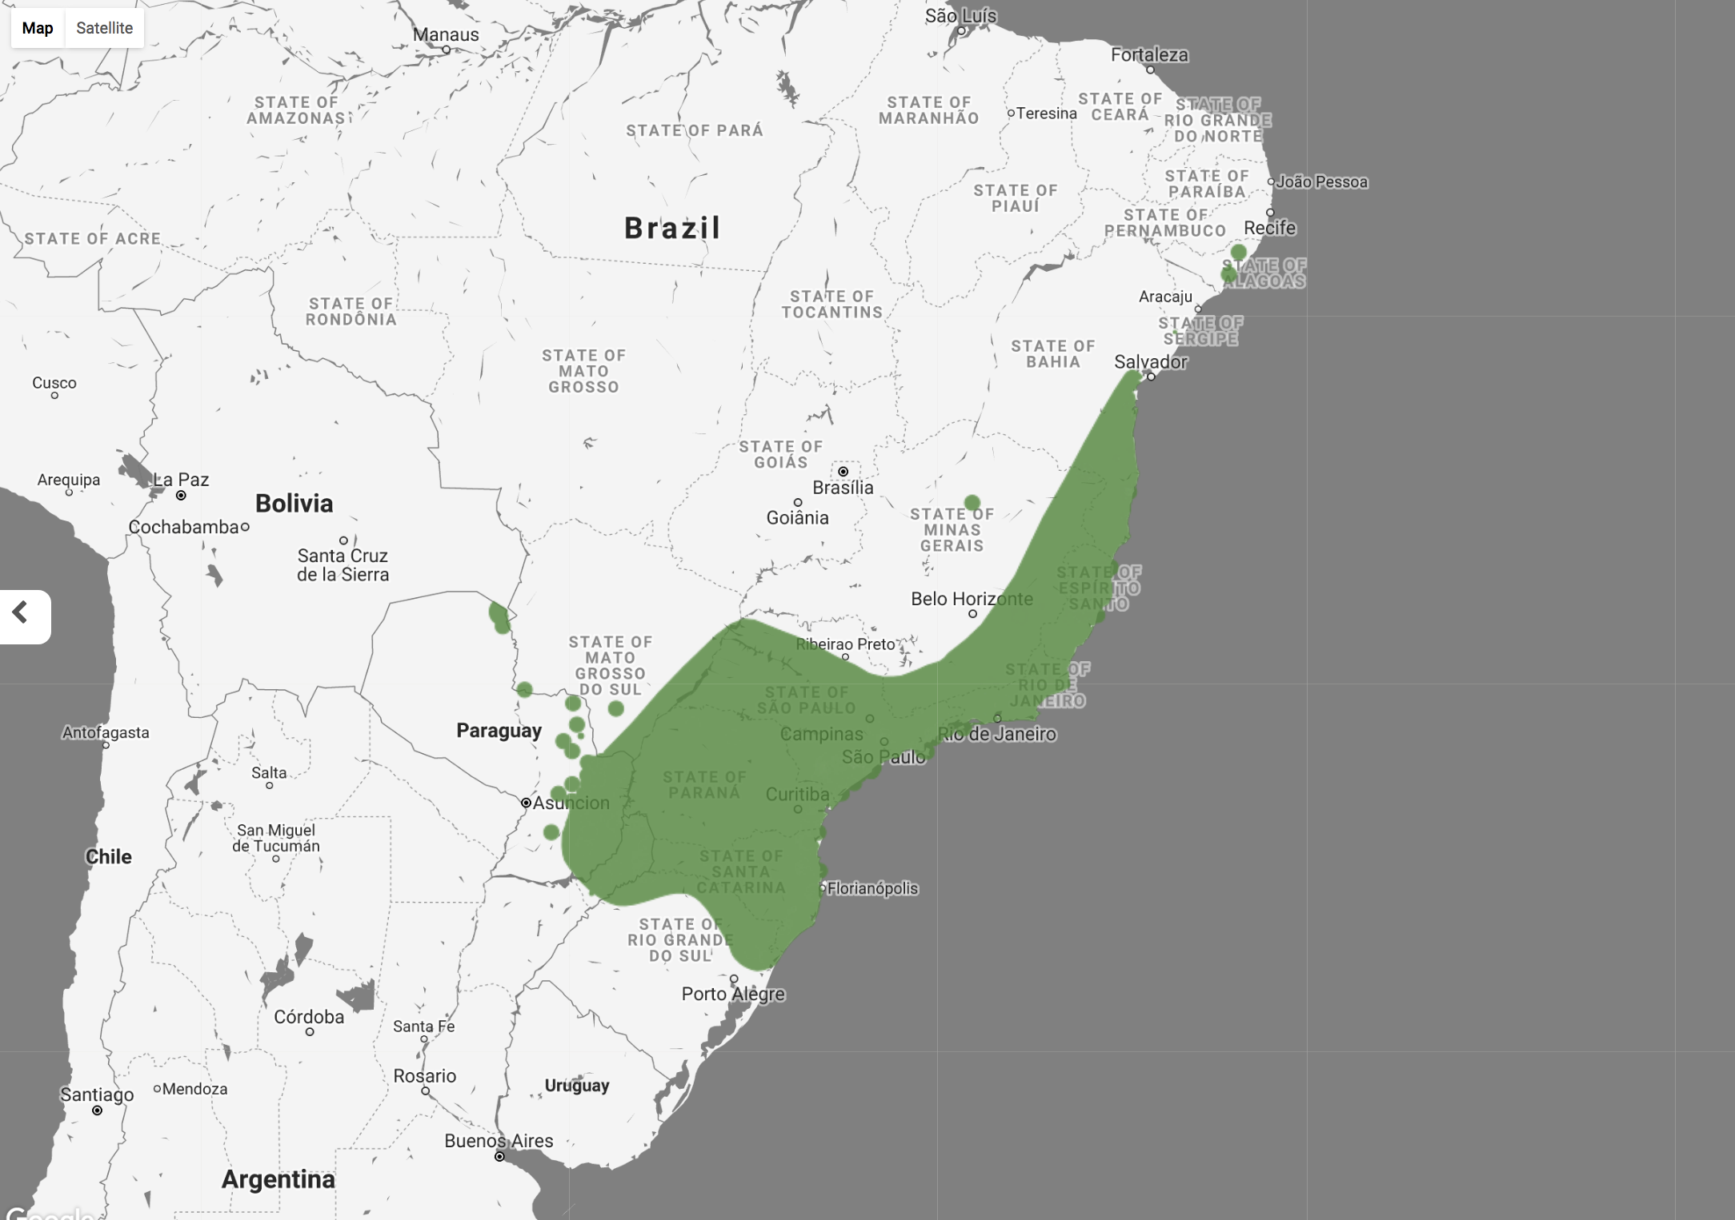
Caveats/Decisions
Not many options for looking at all species
Expert maps OK at coarse grain (0.25 degree -> Country)
No extrapolation beyond the current expert map
No movement
No adaptation
Notes:
I don’t think you want to make a conservation plan based on expected migration. But rather find the places that are safe independent of that

Slide 18
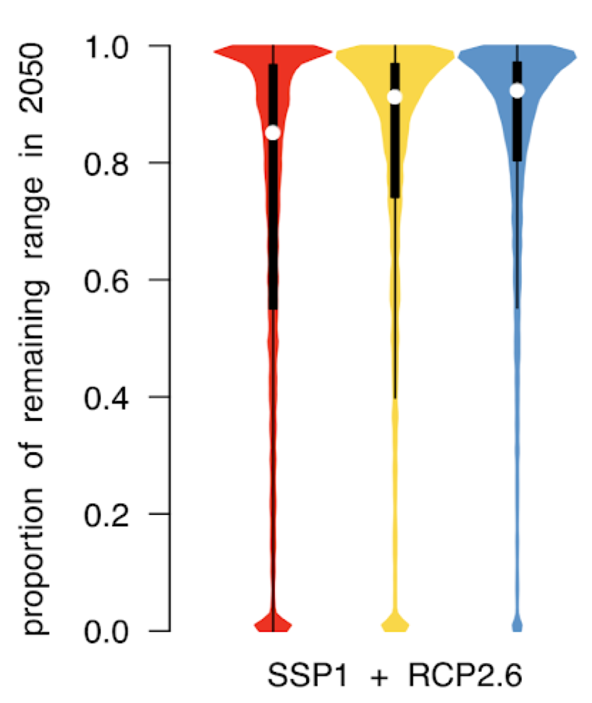
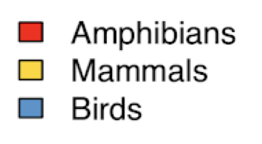
Expected losses…
(Biased toward species you can
build a model for…)
Notes:
Animals not to scale.
Just so you get the magnitude of predicted losses
We’re not predicting that everything goes extinct
Ordering not surprised

Slide 19
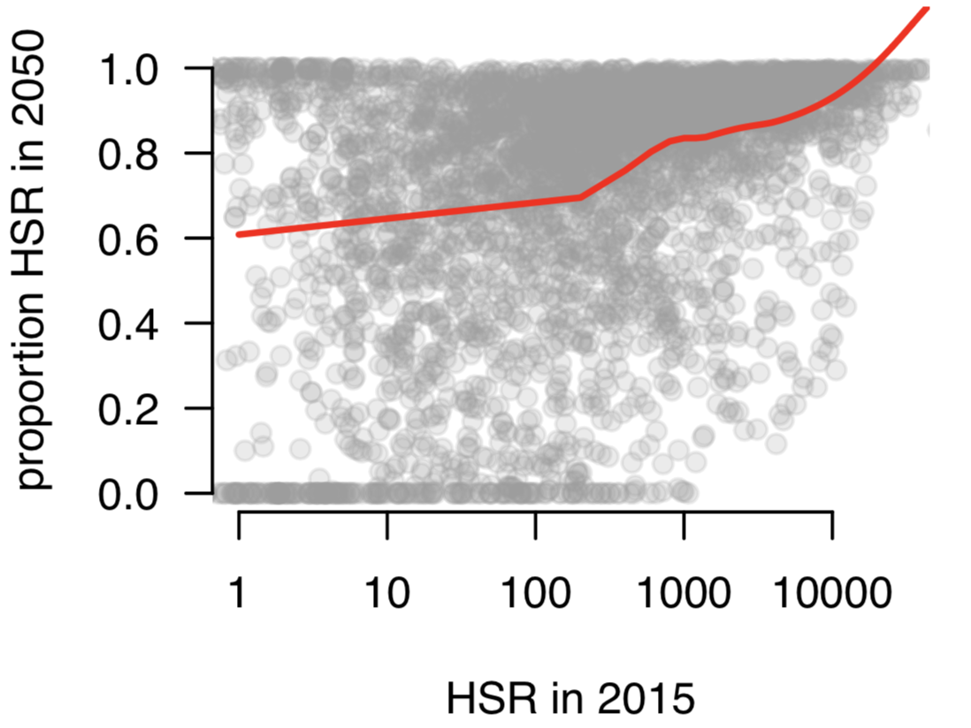
Expected losses…
(Biased toward species you can
build a model for…)
Notes:
Not just small range species

Slide 20
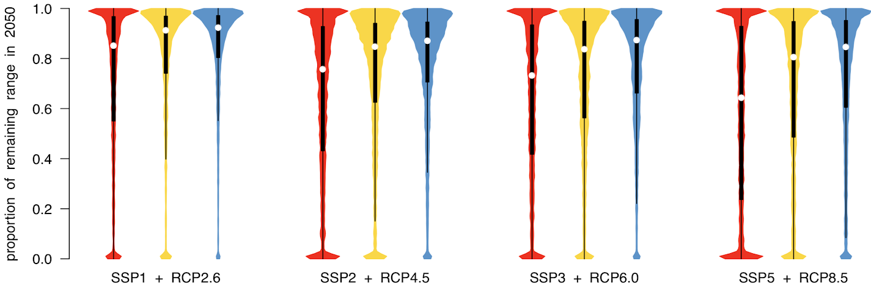
Consistent trends in expected losses…

Slide 21
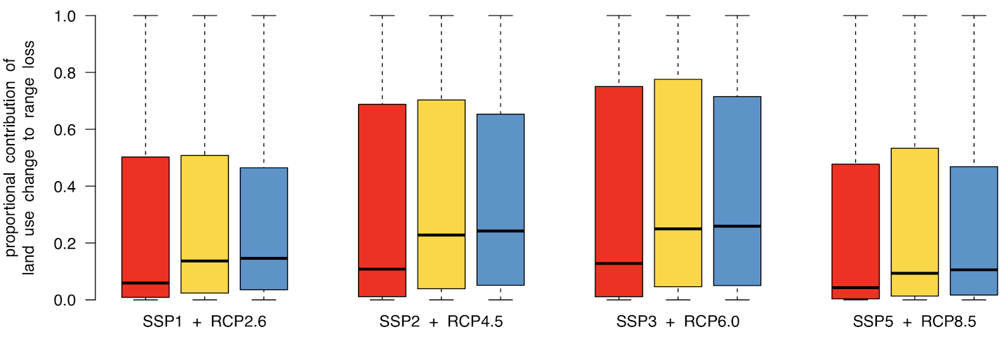
Climate >> Land Use
Find clmate barplots
Maybe show low overlap
Climate has biggest effect on amphibians
Notes:
How many people would’ve guessed this? (vote)
Land use is bad in SSP3 because that the scenario where we continue development but advance technaology to avoid fossil fuels
The overlap of climate and land use is only a few percent so that’s annoying

Slide 22
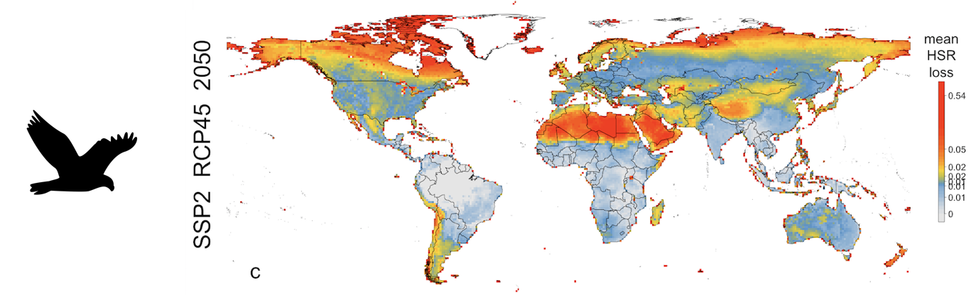
Local loss
In places that are already hot, or should be cold
Notes:
Note quantile scales

Slide 23
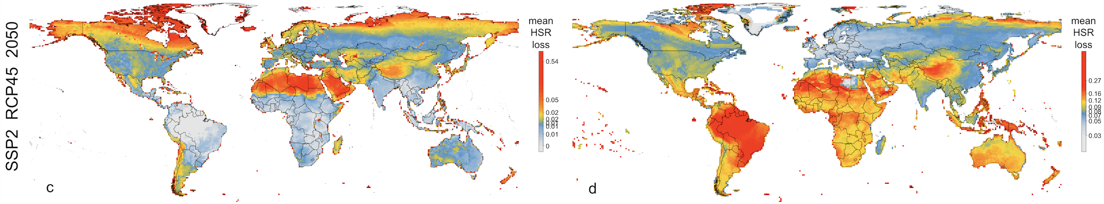
How does global loss
compare to local loss?
Global loss
Notes:
describe

Slide 24
How does global loss
compare to local loss?
Global loss
Local loss
Notes:
Quantile scales
Amazon – local loss is low, but the species there loose a lot of their global range
Arctic – local loss, but wide ranging and tolerant so global loss isn’t as bad

Slide 25
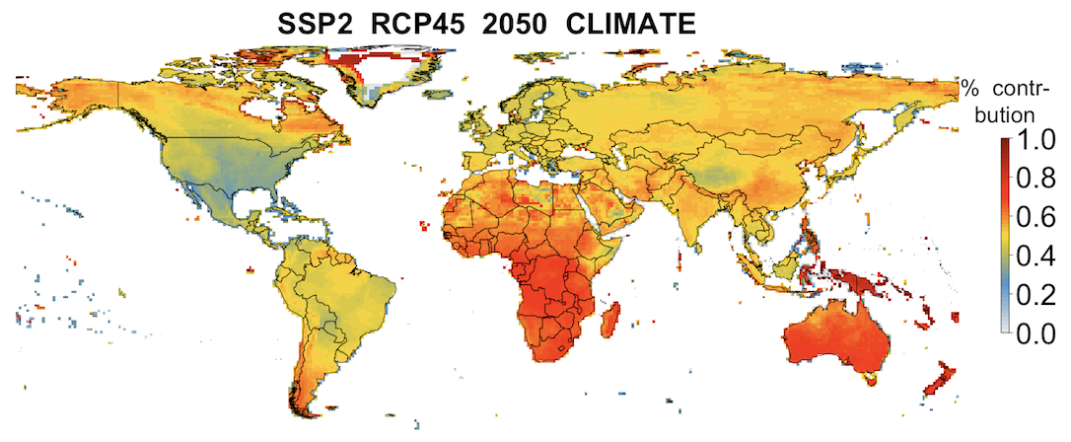
Contribution to climate
Global loss
Proportional contribution of climate
Notes:
Climate is a lot less important to birds

Slide 26
Next steps
Targeted conservation strategies
Low local loss, high global loss, low climate contribution (low risk)
High local loss, high global loss, low climate contribution (high risk, high reward)
Anticipate changing stewardship
Serve to scientific community
Serve for policy

Slide 27
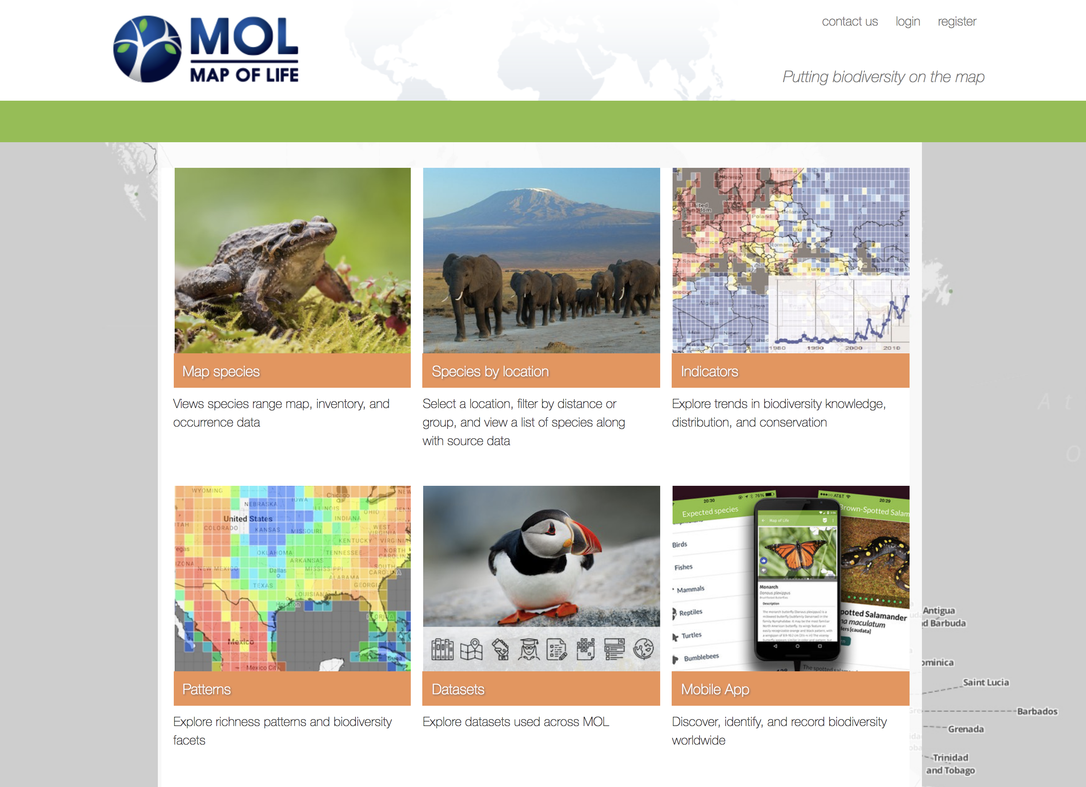
mol.org

Slide 28
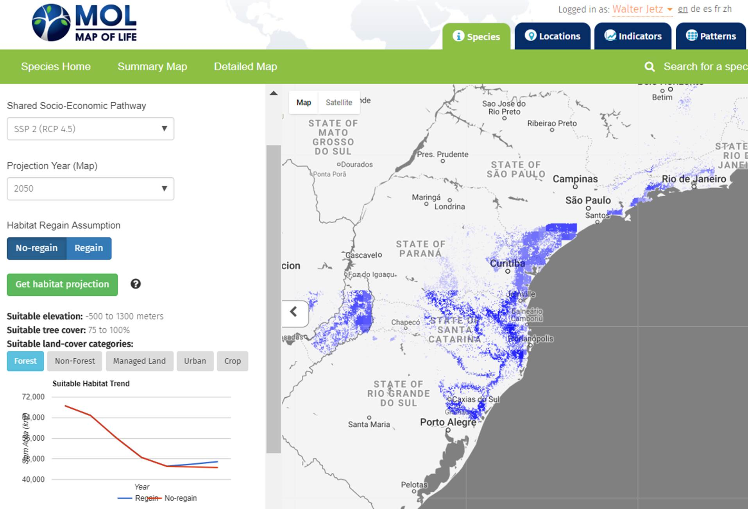
Notes:
Reproducible and dynamically updatable eventually
Map ranges refined by habitat preferences

Slide 29
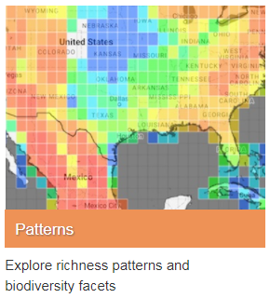
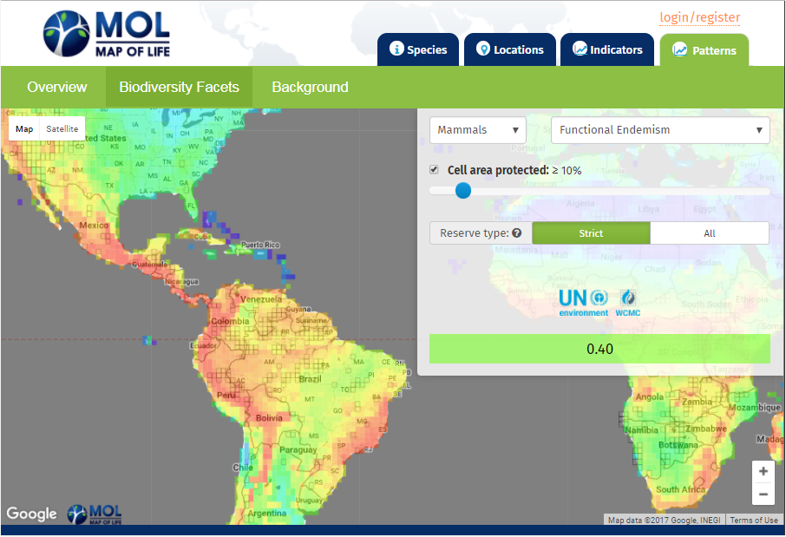
Biodiversity Patterns

Slide 30
Conclusions
Climate >> land use
Environmental change alone doesn’t predict loss
Priorities for loss

Slide 31
Environmental Extrapolation
What assumptions were made?

Slide 32
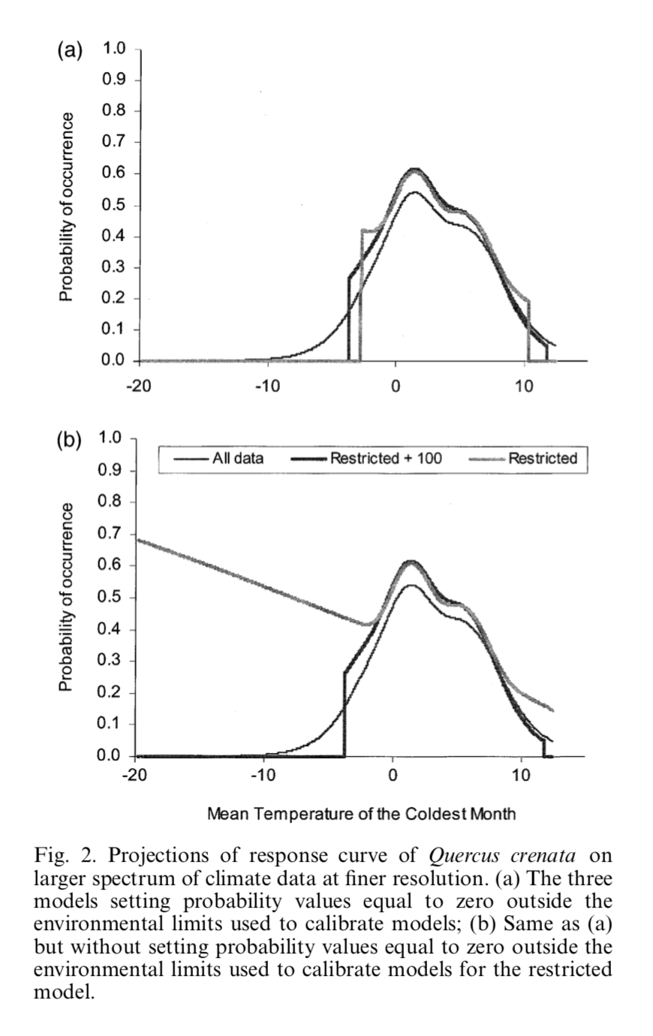
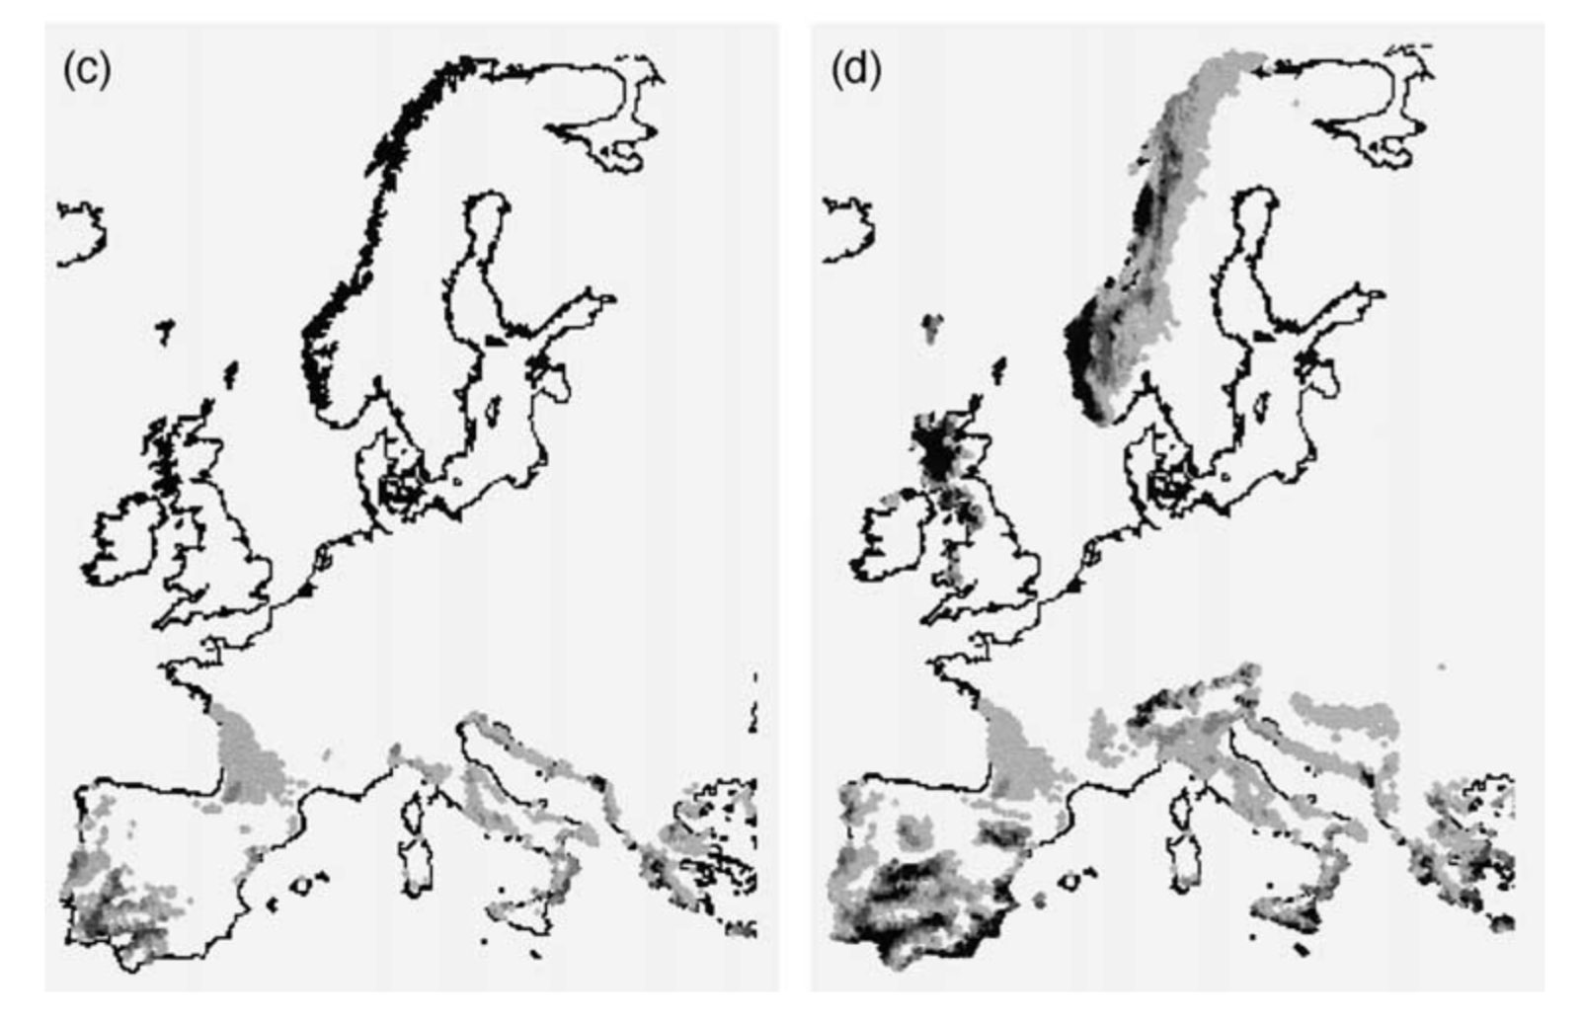
Extrapolation
clamping
oops
Thullier et al. 2004

Slide 33
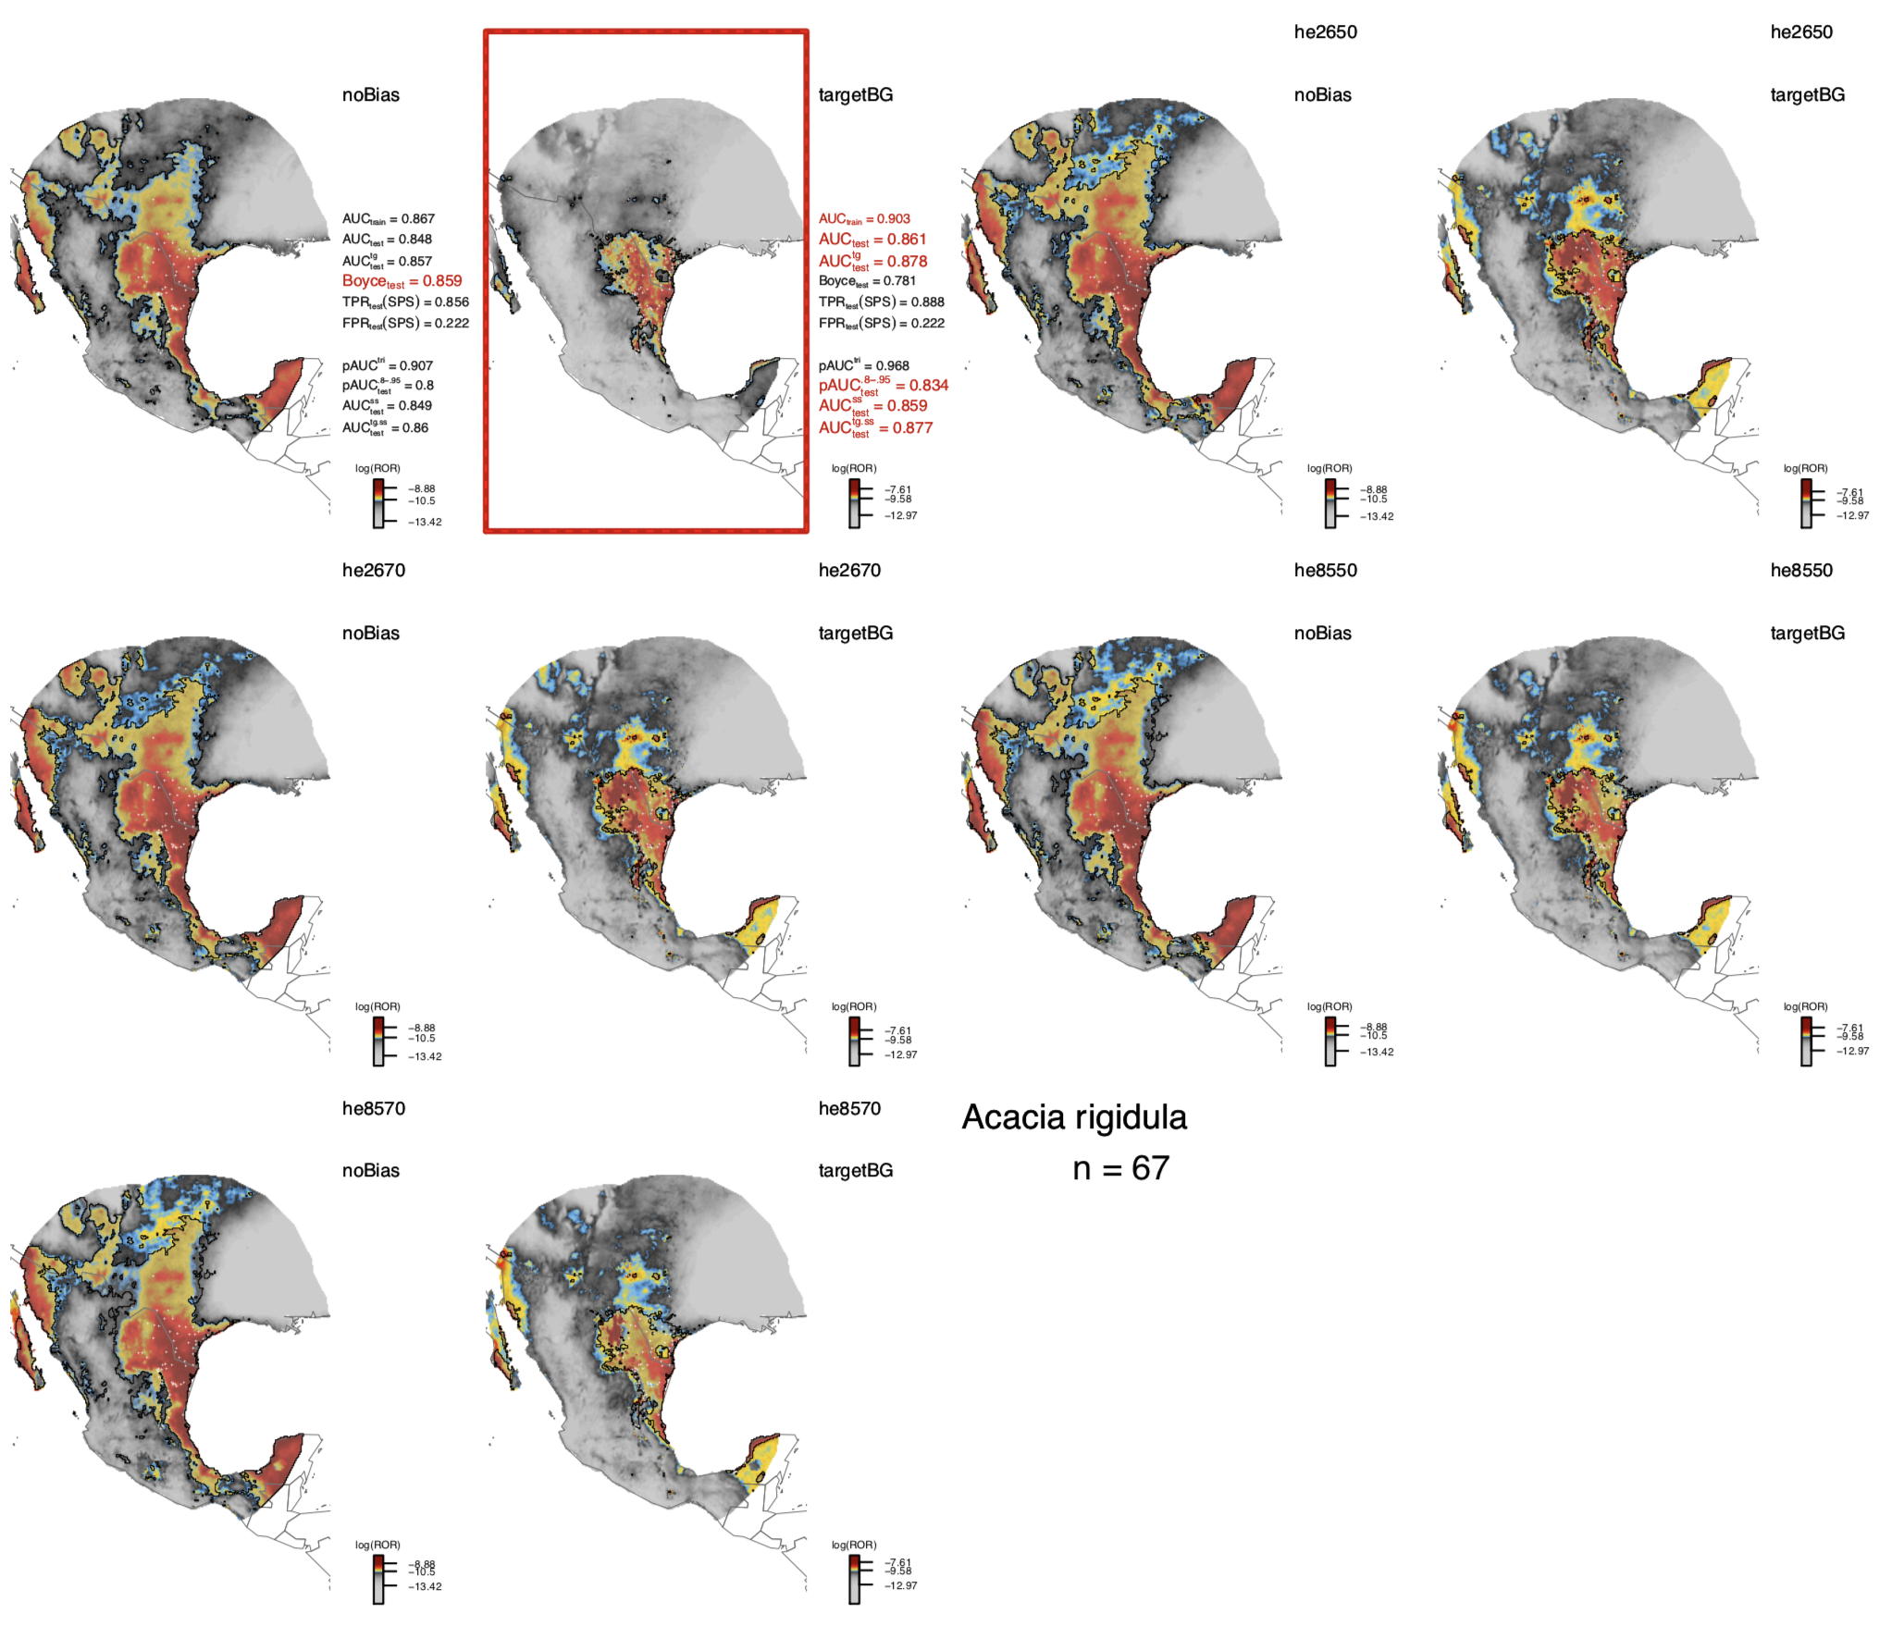
Forecasting
Notes:
We have to do this all the time to predict many species responses to climate change
Focus on 2nd column

Slide 34
What can we do about it?
Don’t do it
Get more data in the range you want to predict
Cross validation

Slide 35
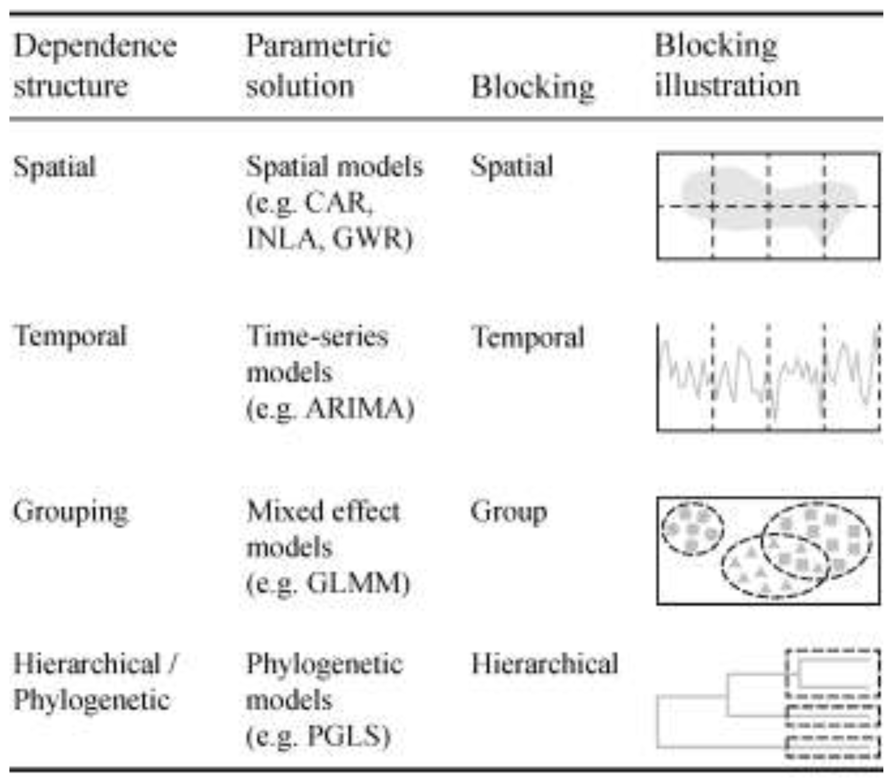
Cross Validation
Roberts et al. 2016, Ecography

Slide 36
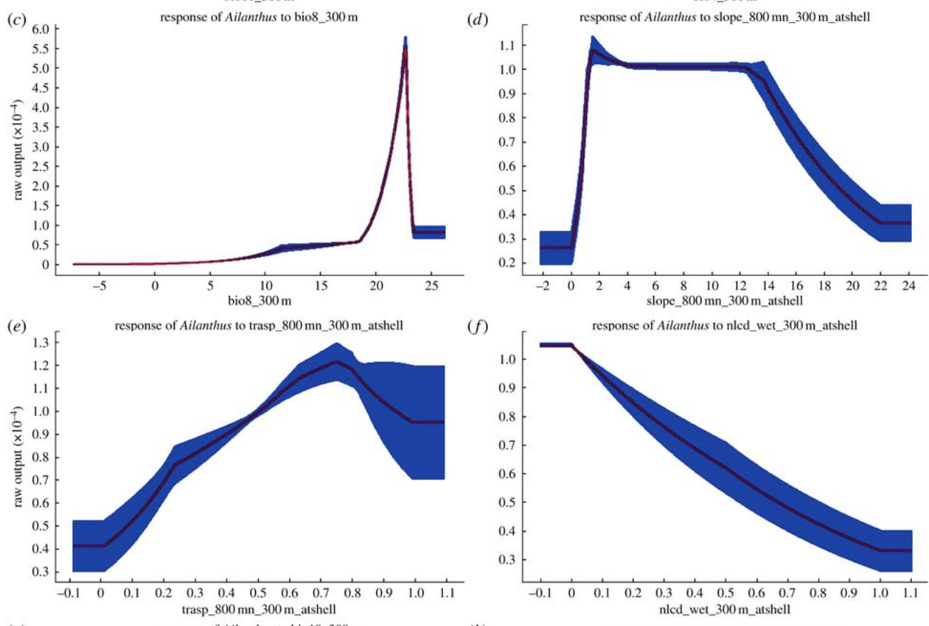
What can we do about it?
Don’t do it
Get more data in the range you want to predict
Cross validation
Constrain it

Slide 37
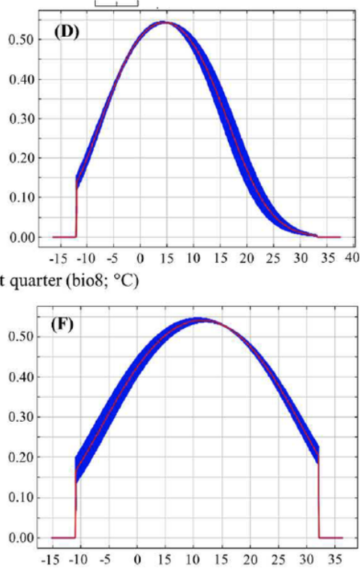
What can we do about it?
Don’t do it
Get more data in the range you want to predict
Cross validation
Constrain it
Make a heuristic argument that its ok

Slide 38
What can we do about it?
Don’t do it
Get more data in the range you want to predict
Cross validation
Constrain it
Make a heuristic argument that its ok
Make a mechanistic model
Predict another emergent pattern to validate the extrapolation with a different type of data

Slide 39
Spatial Extrapolation

Slide 40
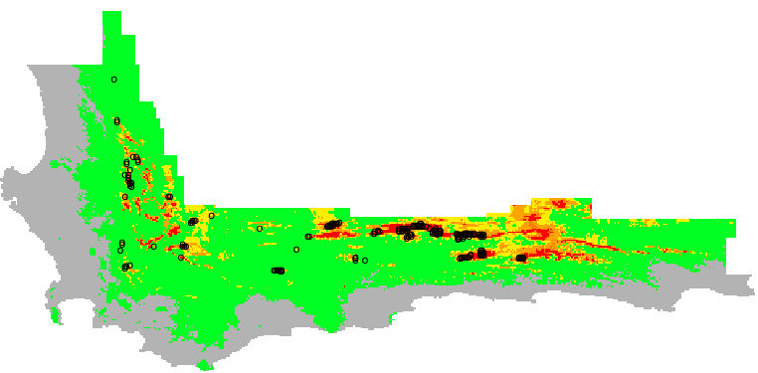
Two cultures of SDMing
occurrence
Bumps attributed to environmental response actually arise in geographic space

Slide 41
Spatial Aggregation and Overfitting
Cold (Suitable)
Warm (Unsuitable)

Slide 42
Overfitting
Cold (Suitable)
Warm (Unsuitable)

Slide 43
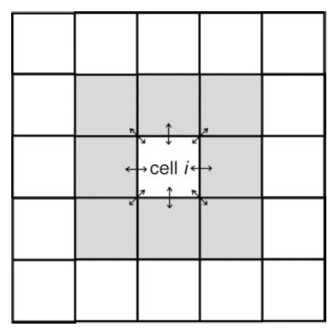
Bayesian Spatial models
Spatial random intercepts
R package: hSDM
Notes:
Conditional Autoregressive Model
no software previously for point models
Uncertainty can be underestimated with spatially correlated data

Slide 44
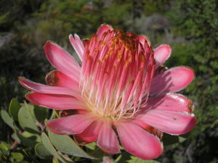
Spatial prediction
Elevation
Mean
Data

Slide 45
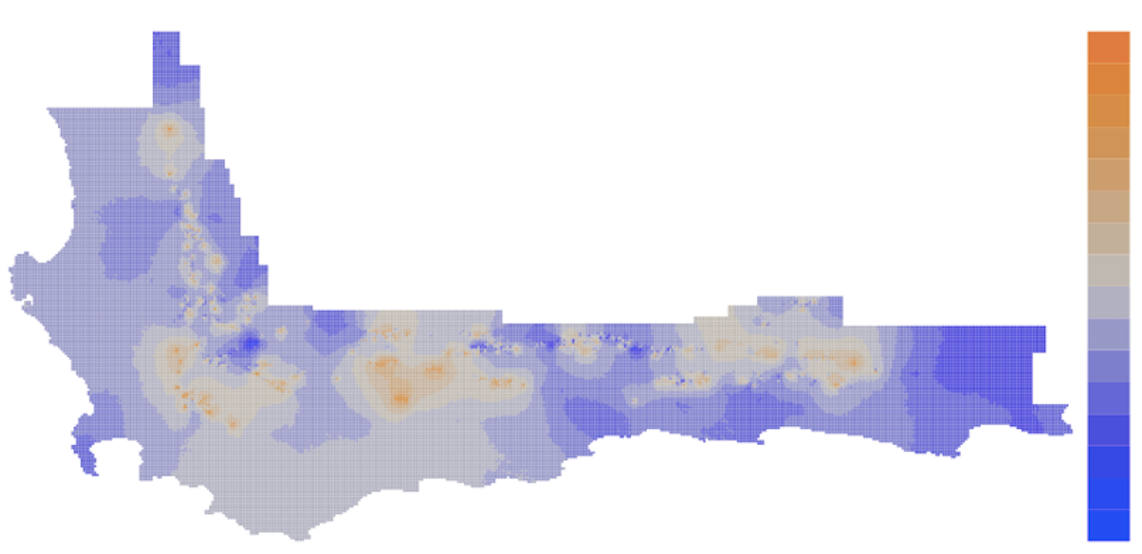
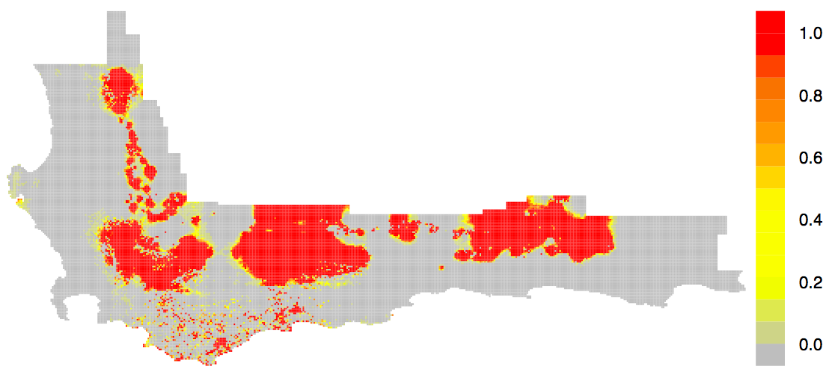
Spatial prediction
Spatial Effects
Data
Accurate Spatial Prediction
Generalization
Notes:
Shows that a lot of predictive accuracy is coming from things that we’ve ommitted from the model.

Slide 46
Temporal Extrapolation

Slide 47
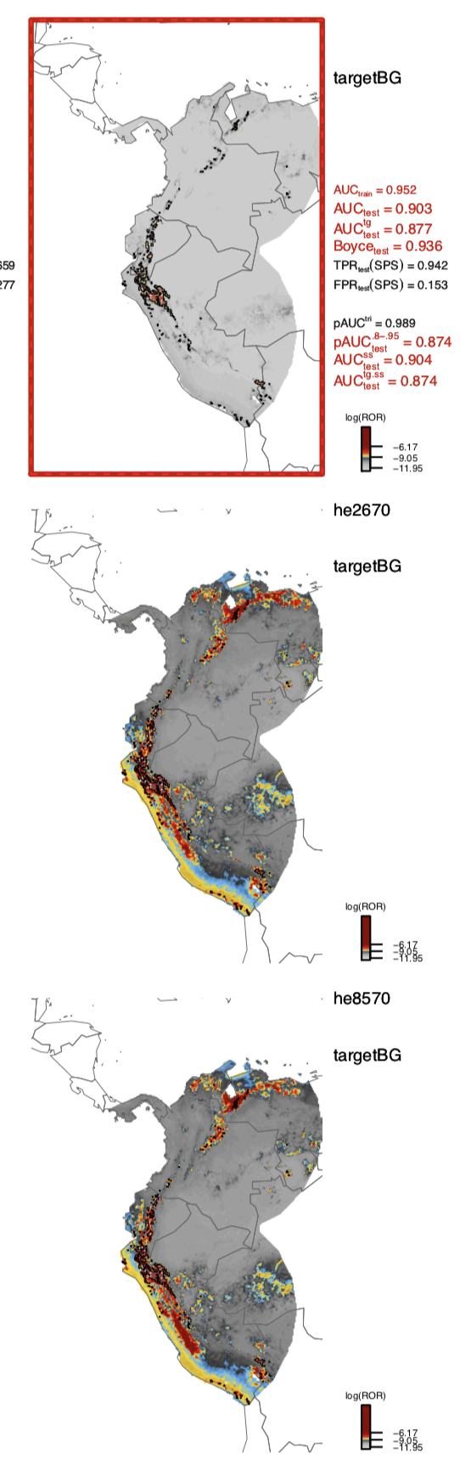
Temporal extrapolation
Correlative models can only take you so far….

Slide 48
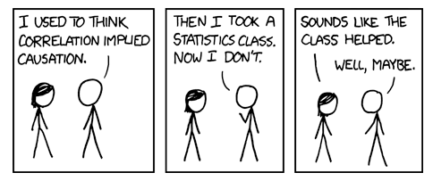
Forecasting
And the need for mechanism…
http://xkcd.com
Notes:
Forecasting often requires extrapolation to new conditions where we have no data, and where models are most uncertain
fire trucks responding to fire/amount of damage the fire does

Slide 49
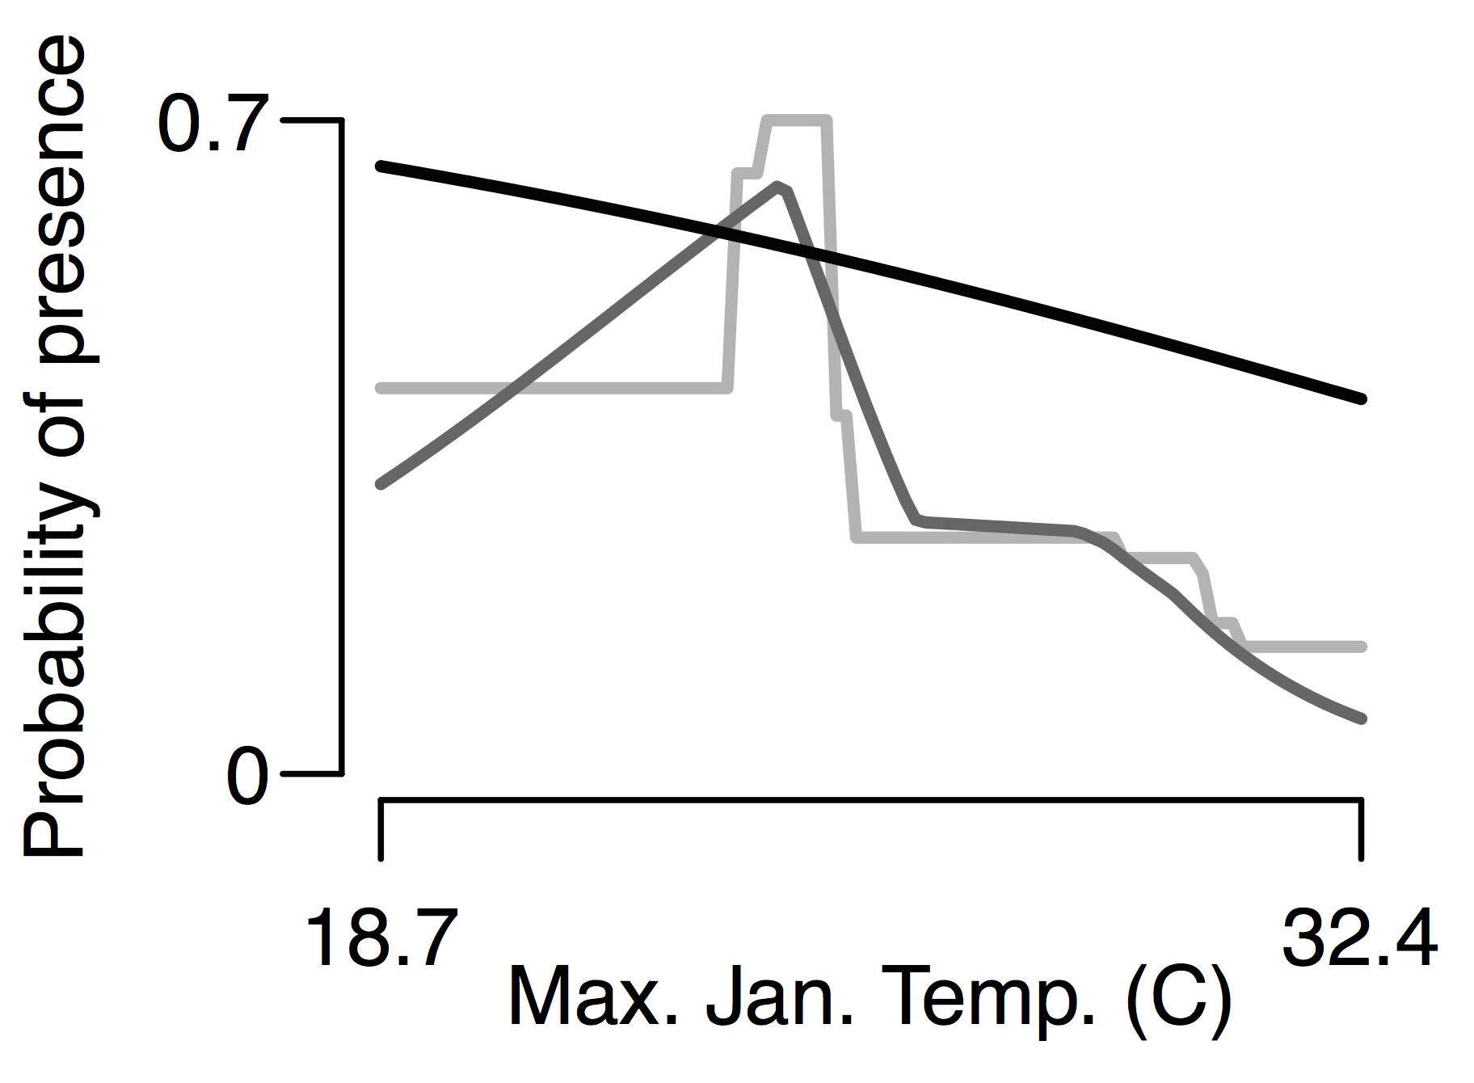
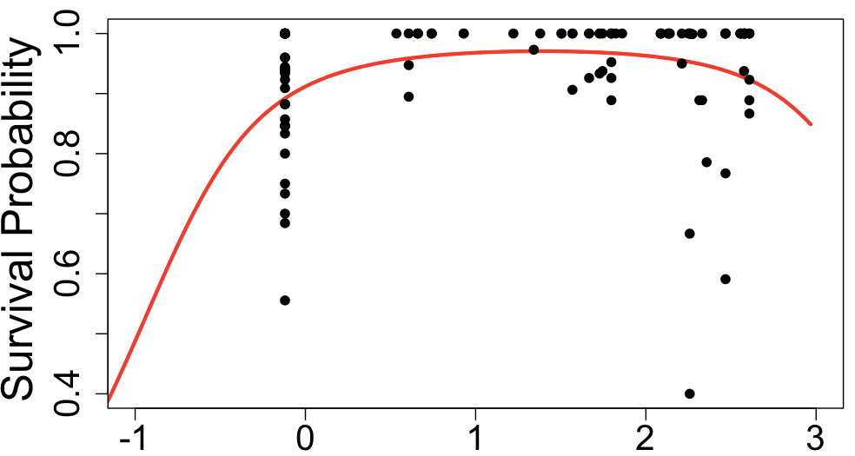
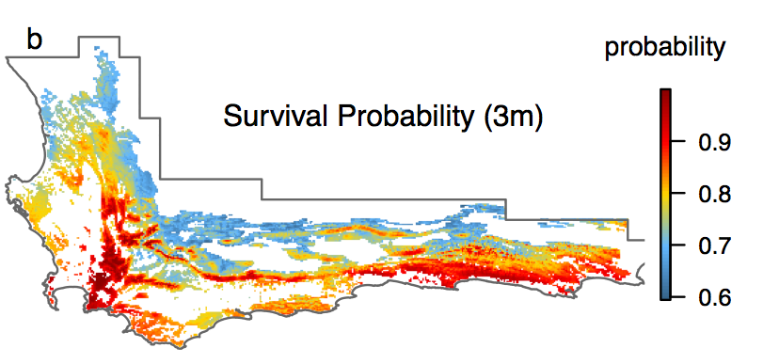

Correlative
Mechanistic
Correlative models are only useful if things don’t change too much
Need a forest
example of
something going
wrong!!
Summer rainfall
Notes:
Correlative models relate the pattern (e.g. spatial distribution) to predictors
Mechanistic models relate the process (e.g. demography, dispersal) to predictors

Slide 50
Uncertainty
Modeling decisions
Parameters
Future Scenarios

Slide 51
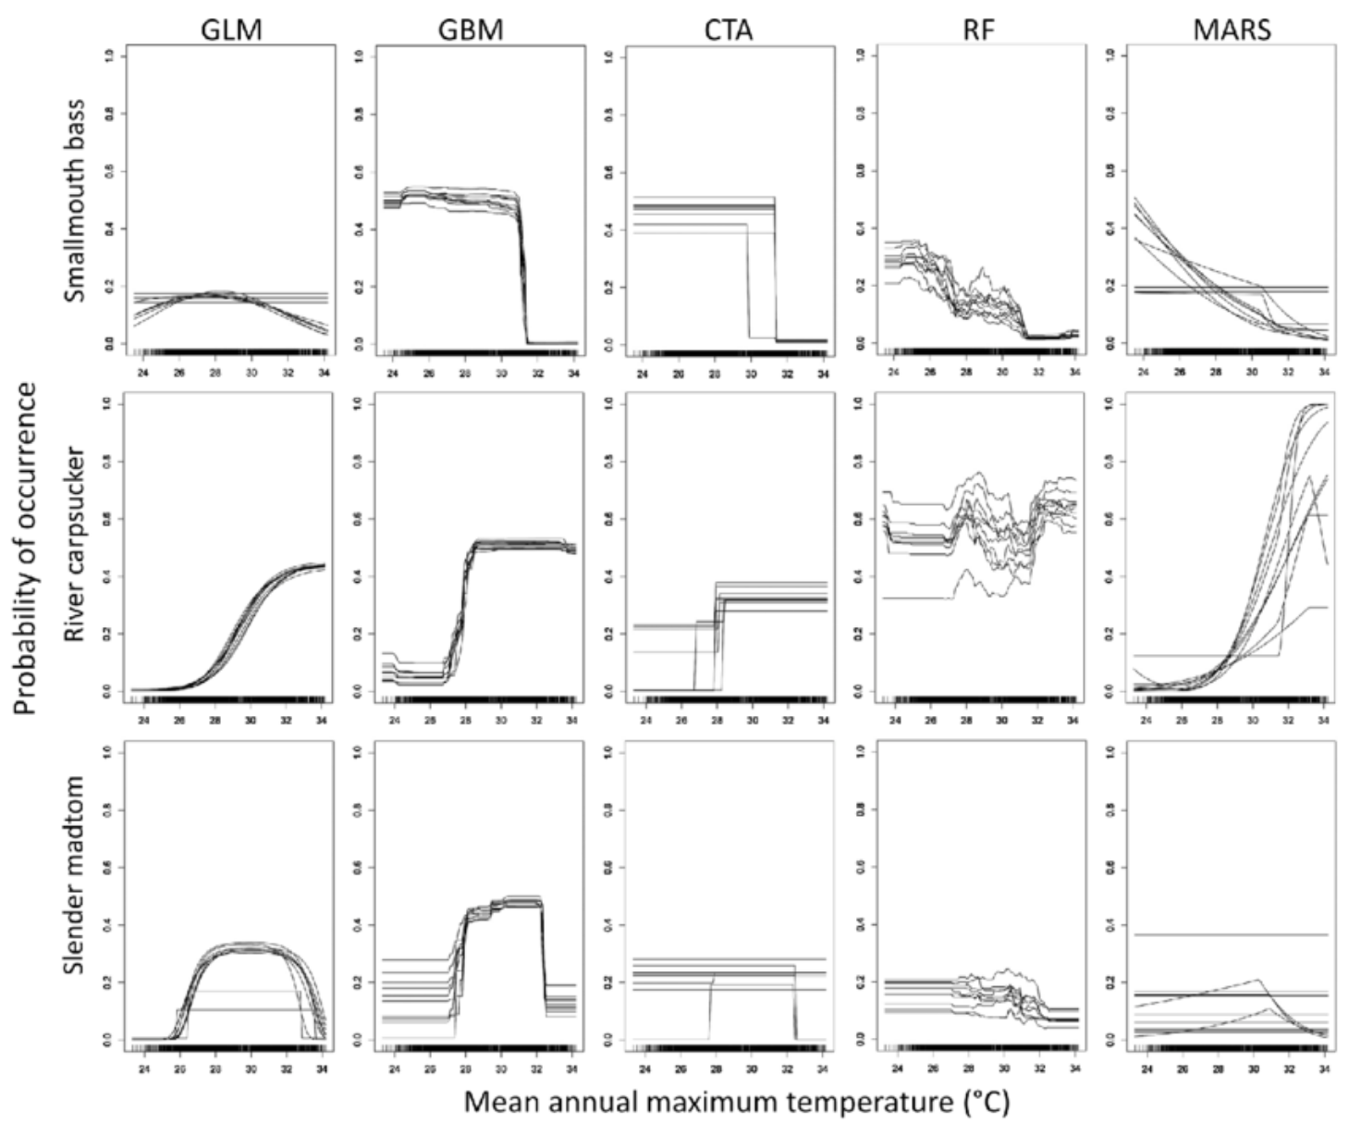
Modeling decisions: algorithms

Slide 52
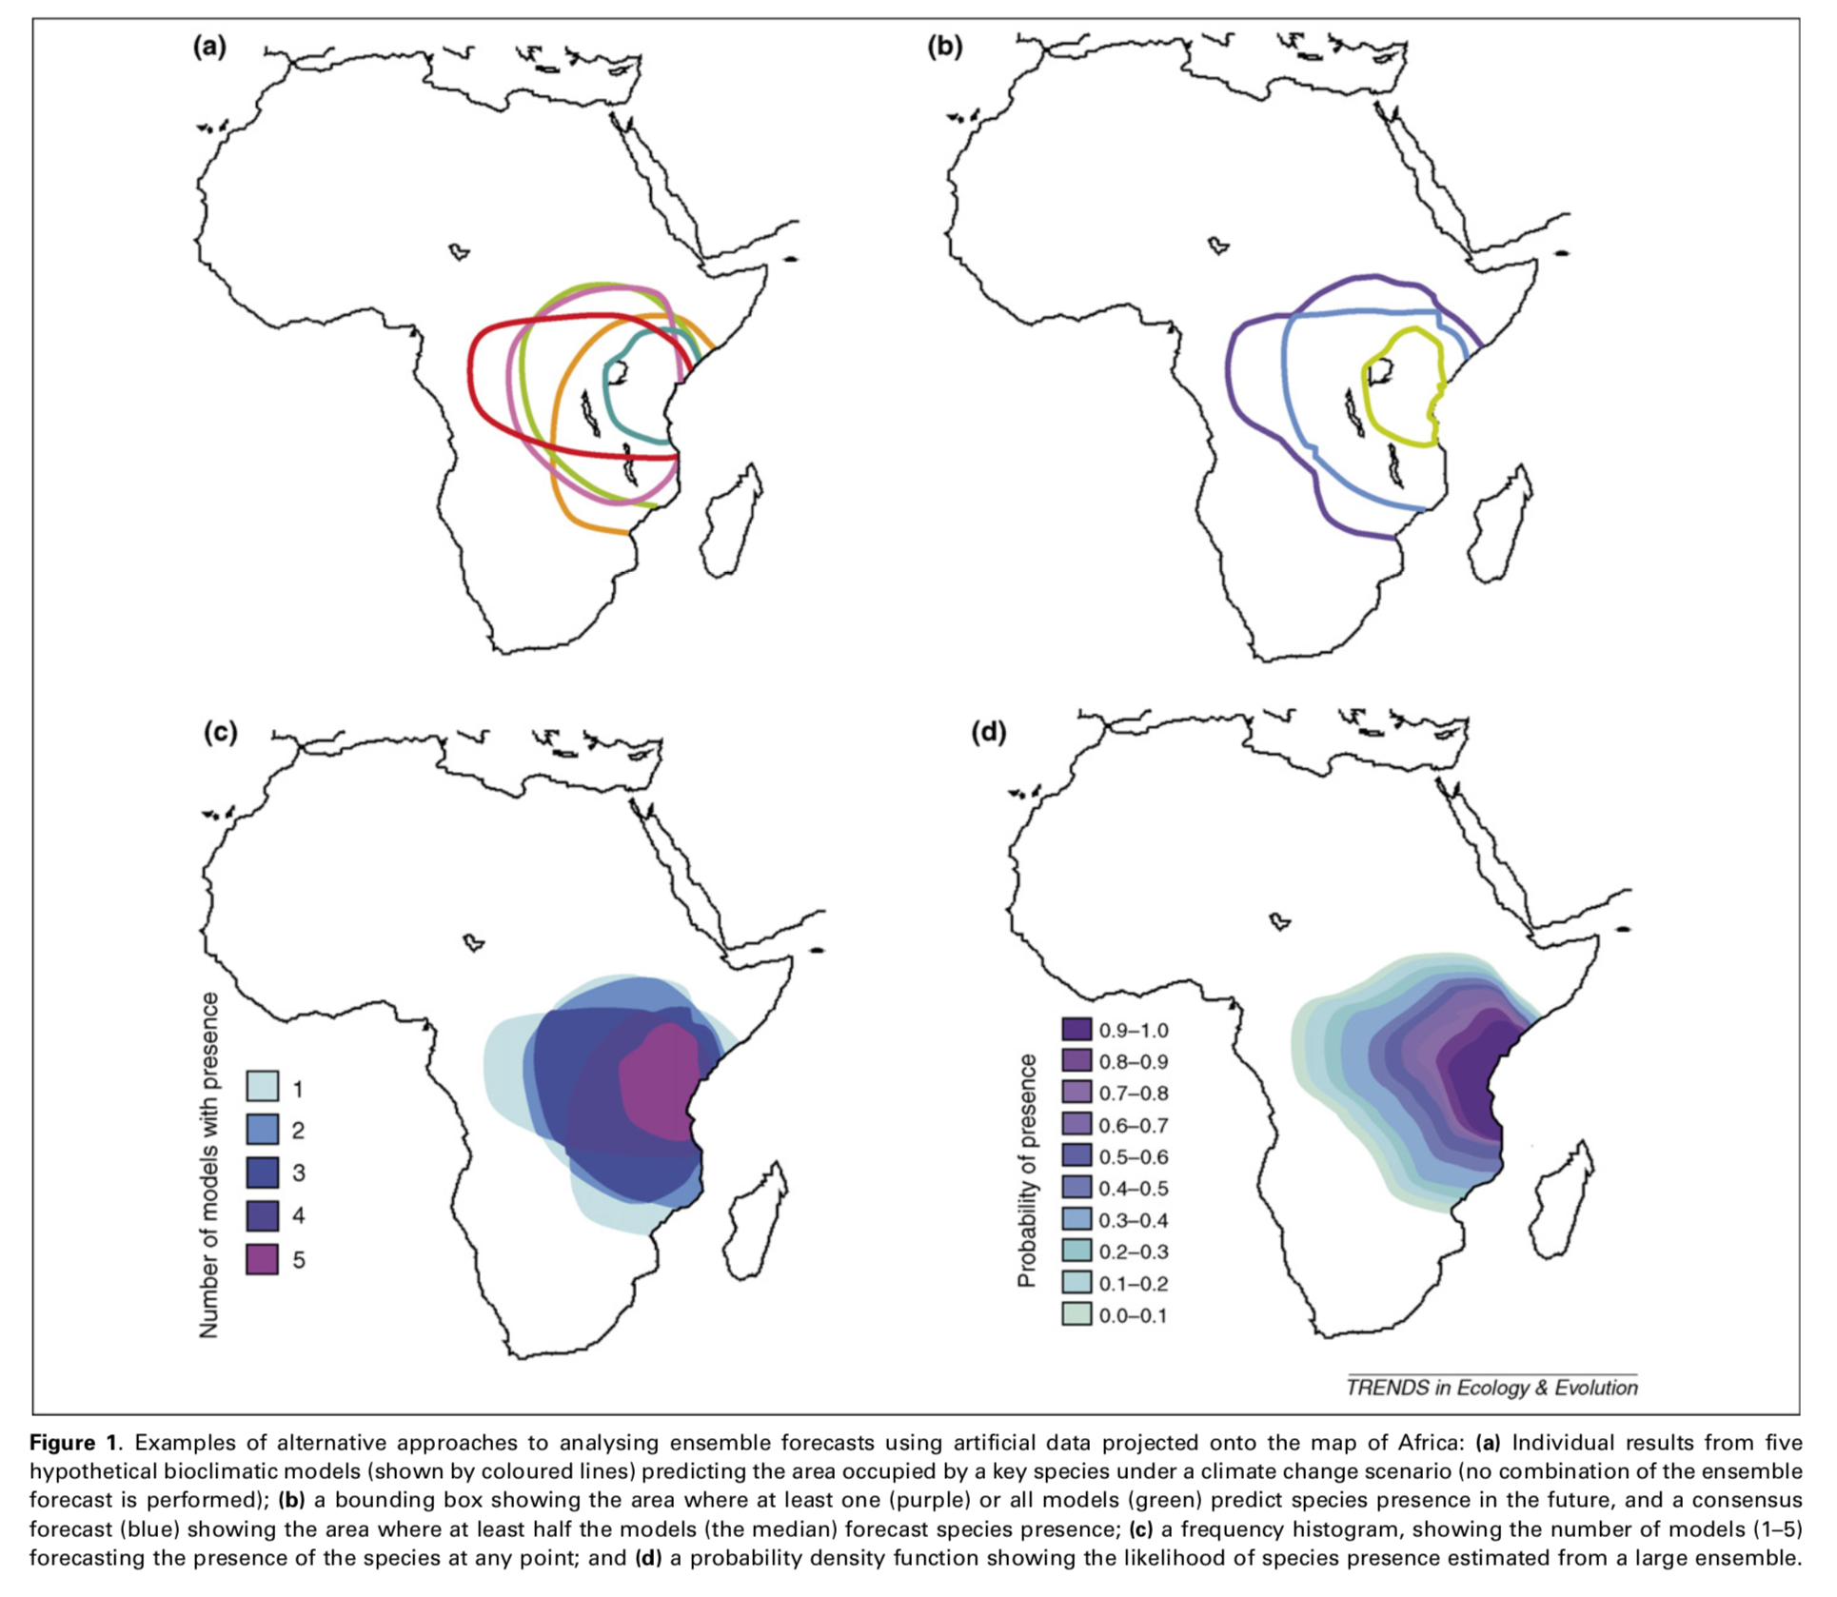
Modeling decisions: ensembles

Slide 53
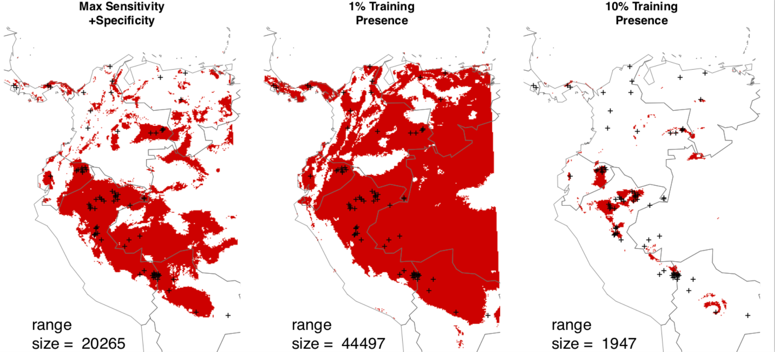
Modeling Decisions: Binary Maps
Determining the right threshold is dodgy with presence – only data
Merow et al, pretty soon
Set up the problem
Notes:
Nede binary for diversity, community, visualization, interacations.
My original solution was to complain about it when people did this as arbitrary.
it might be hard to. deterimine a single best threshold, but putting reasonable bounds is much easier. The issue is that the background points aren’t absences, so AUC isn’t ideal.
For conservation, you’re probably worried about the best habitat, not shitty places, so a higher threshold is more useful
Can be combined with other sources of uncertainty/variability, e.g. statistical, algorithm, predictors, etc.
Also just good for visualization for nonspecialists.
get distribution of range size estimated\\

Slide 54

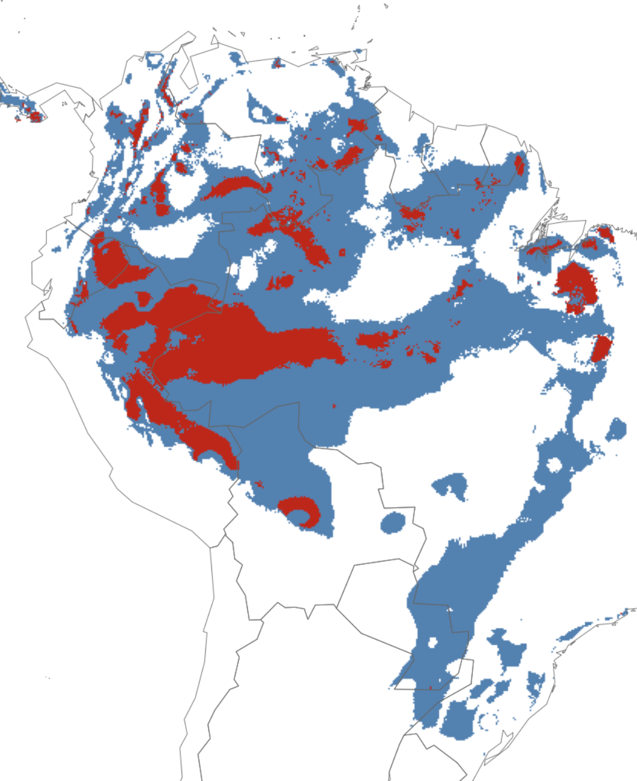
Modeling Decisions: Binary vs. Trinary Maps
Merow et al, pretty soon
Set up the problem
Notes:
Nede binary for diversity, community, visualization, interacations.
it might be hard to. deterimine a single best threshold, but putting reasonable bounds is much easier. The issue is that the background points aren’t absences, so AUC isn’t ideal.
For conservation, you’re probably worried about the best habitat, not shitty places, so a higher threshold is more useful
Can be combined with other sources of uncertainty/variability, e.g. statistical, algorithm, predictors, etc.
Also just good for visualization for nonspecialists.
get distribution of range size estimated\\

Slide 55
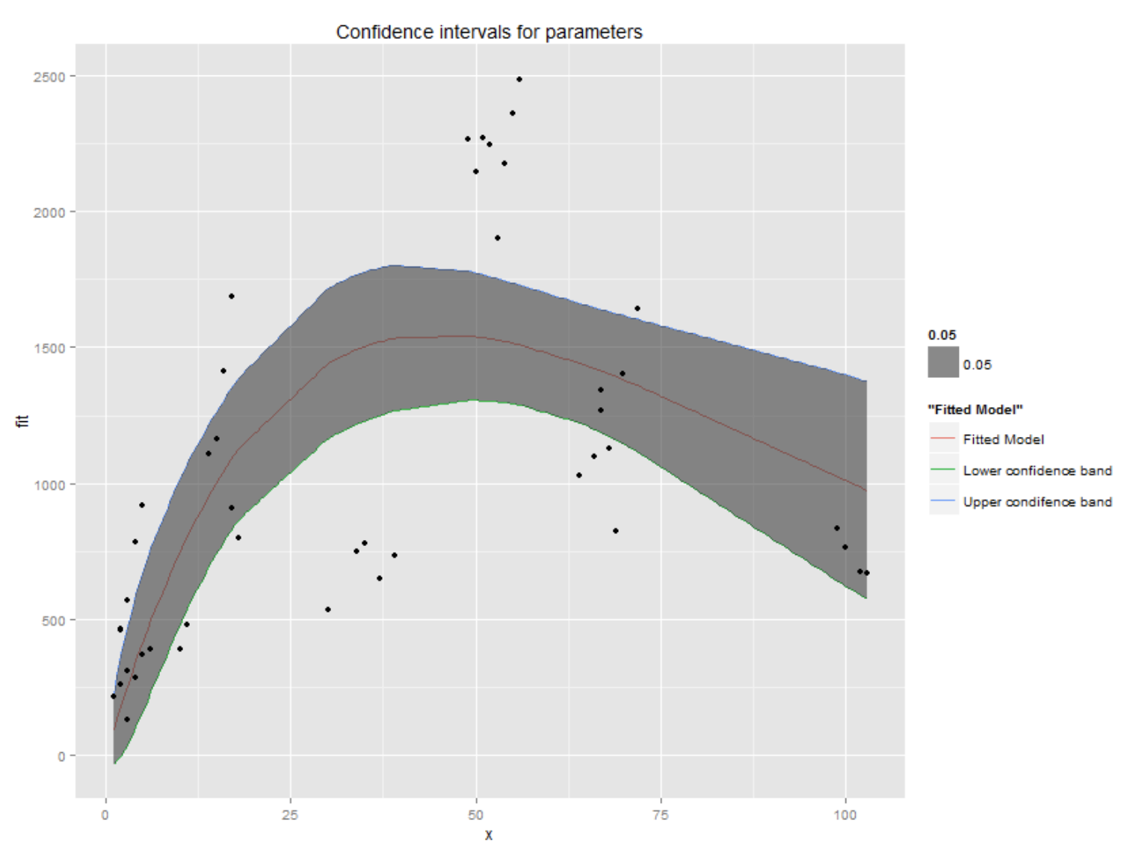
Parameter Uncertainty
Occurrence probability
Notes:
Model uncertainty correctly + Report interval estimates -> flexibility in piecing together data sets -> criticial if we’re going to use existing data to build mechanistic forecasts
-formulate hypotheses for missing data in terms of priors
-these are not huge, crazy Bayesian models, just easy little ones
-Gibbs sampling allows us to track covariance among parameters in complex models
-Choose realistic combinations of parameters for simulations
-Can also partition variation in lambda into the proportion due to variability and uncertainty like margaret has done wish Bayesian matrix models

Slide 56
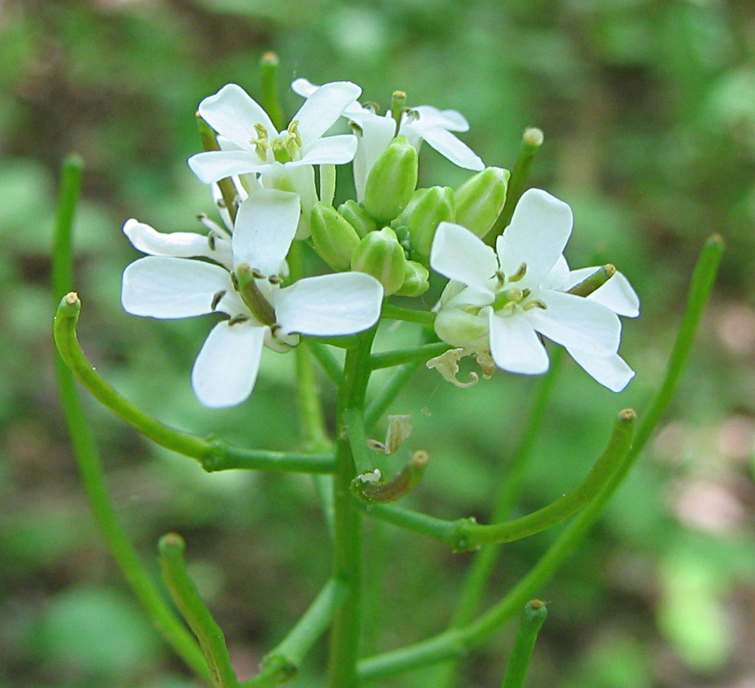
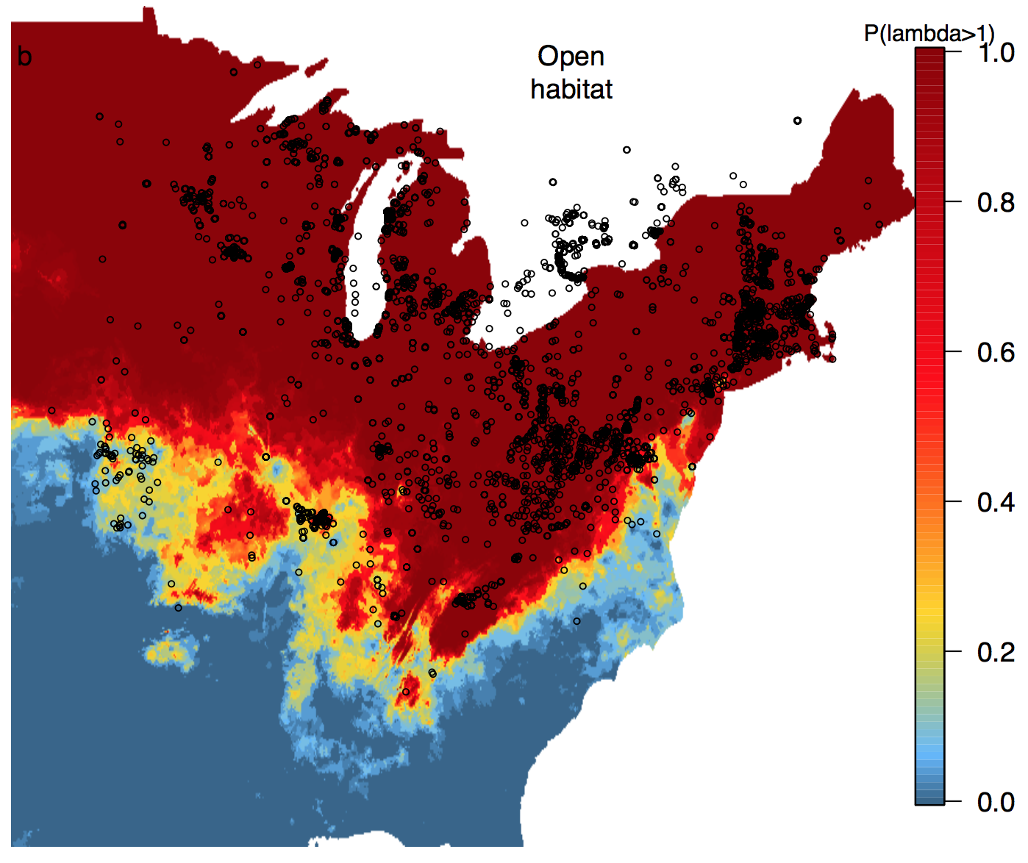
Parameter Uncertainty
Merow, et al. 2017, PNAS
Notes:
Some of the highest fluctuations in temp in the country
Not accounting for any other predictors!

Slide 57
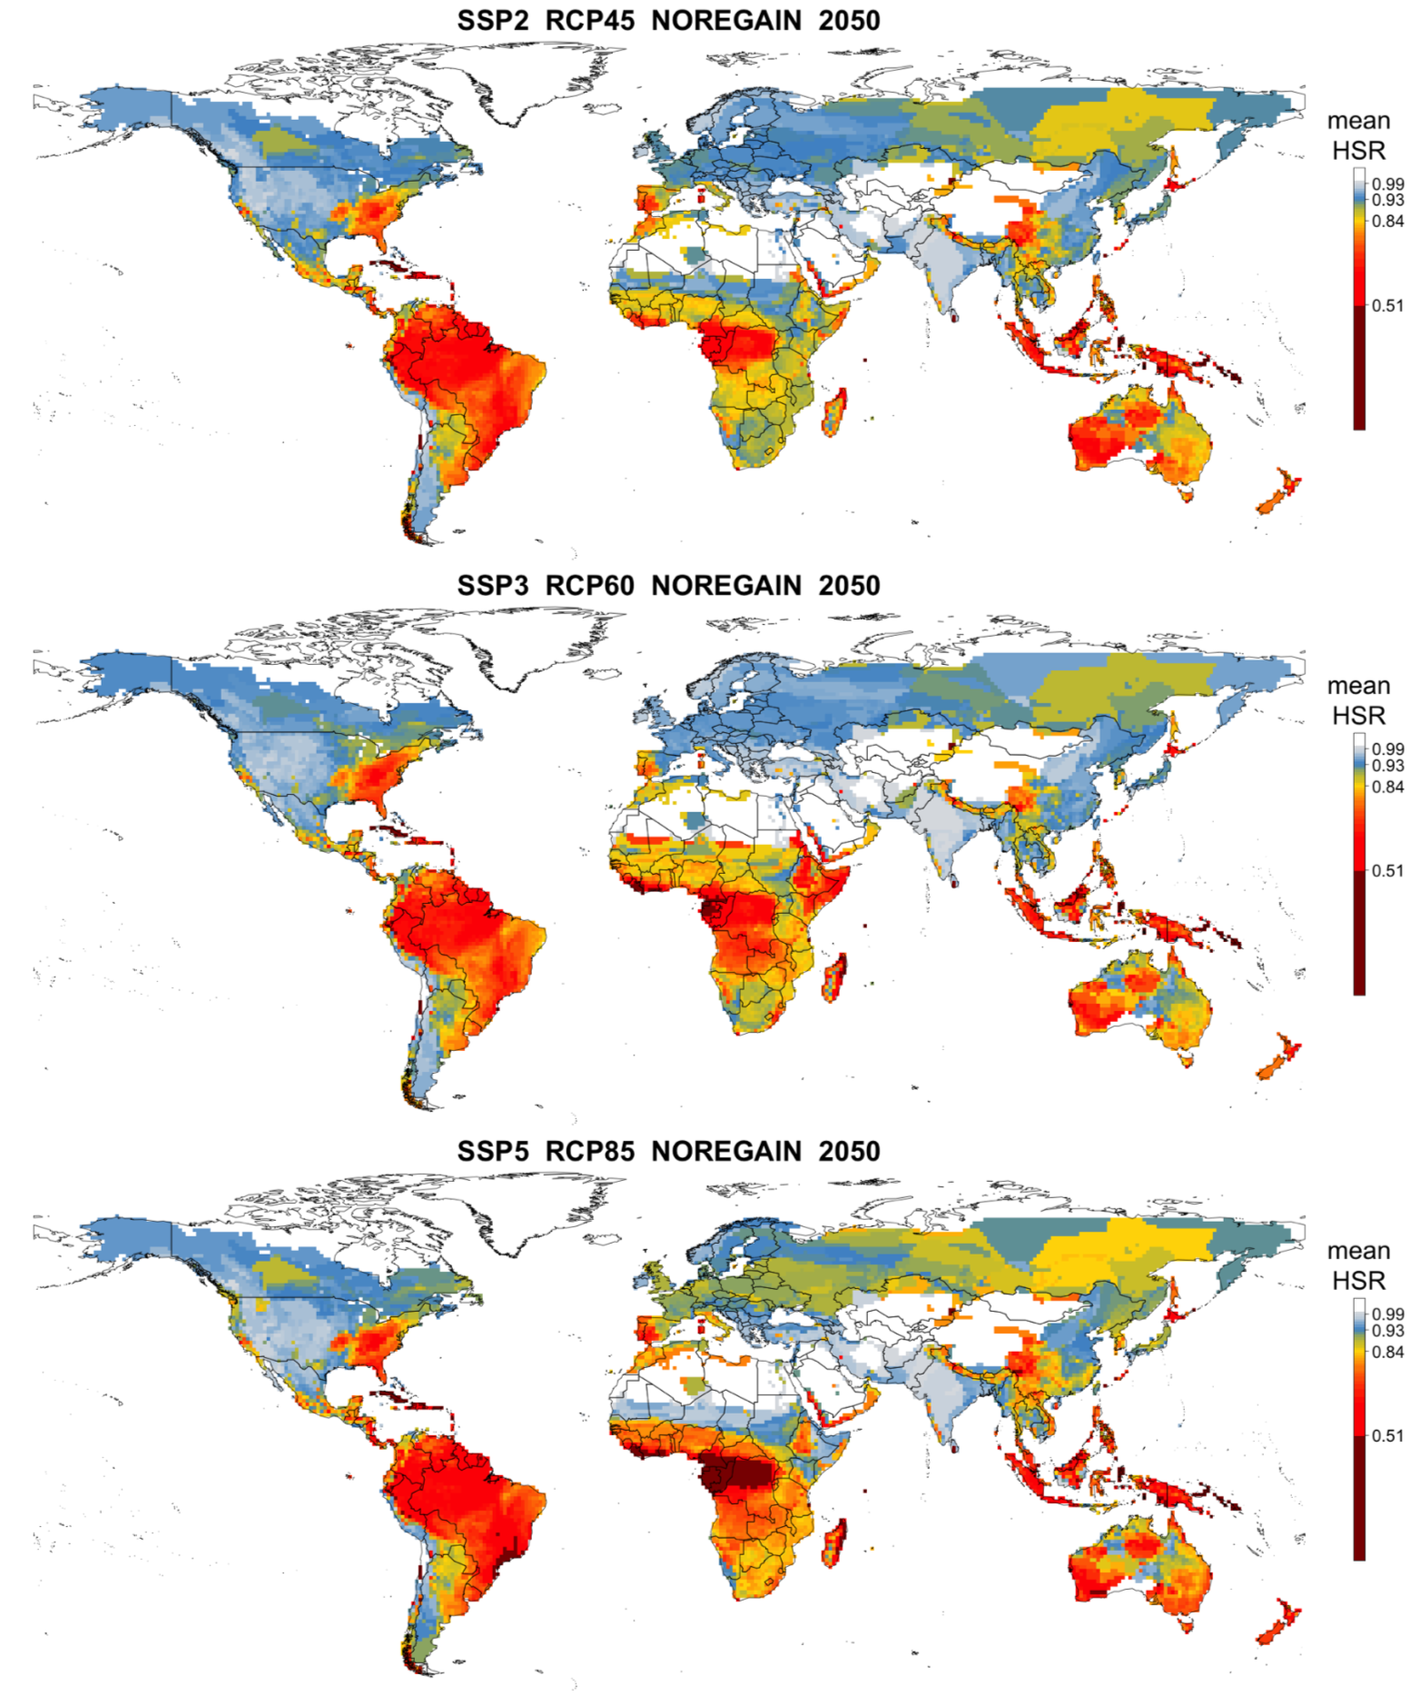
Future scenarios
Weather
Climate
Land Use
Disperal

Slide 58
Concluding thoughts
Types of extrapolation
Environment
Space
Time
Uncertainty
Modeling decisions
Parameters
Future Scenarios
Identify the type
Reduce, report

